Slide 1
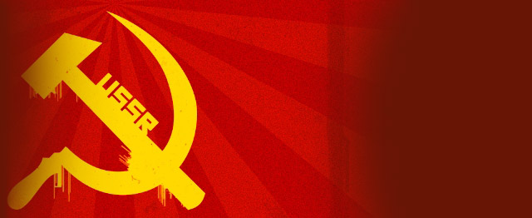
USSR On the Road to War
By: Natalie Jimenez, Samantha Gatti, Mackenzie Henderson, Jordan Crenshaw
Isabelle Pavajeau

Slide 2
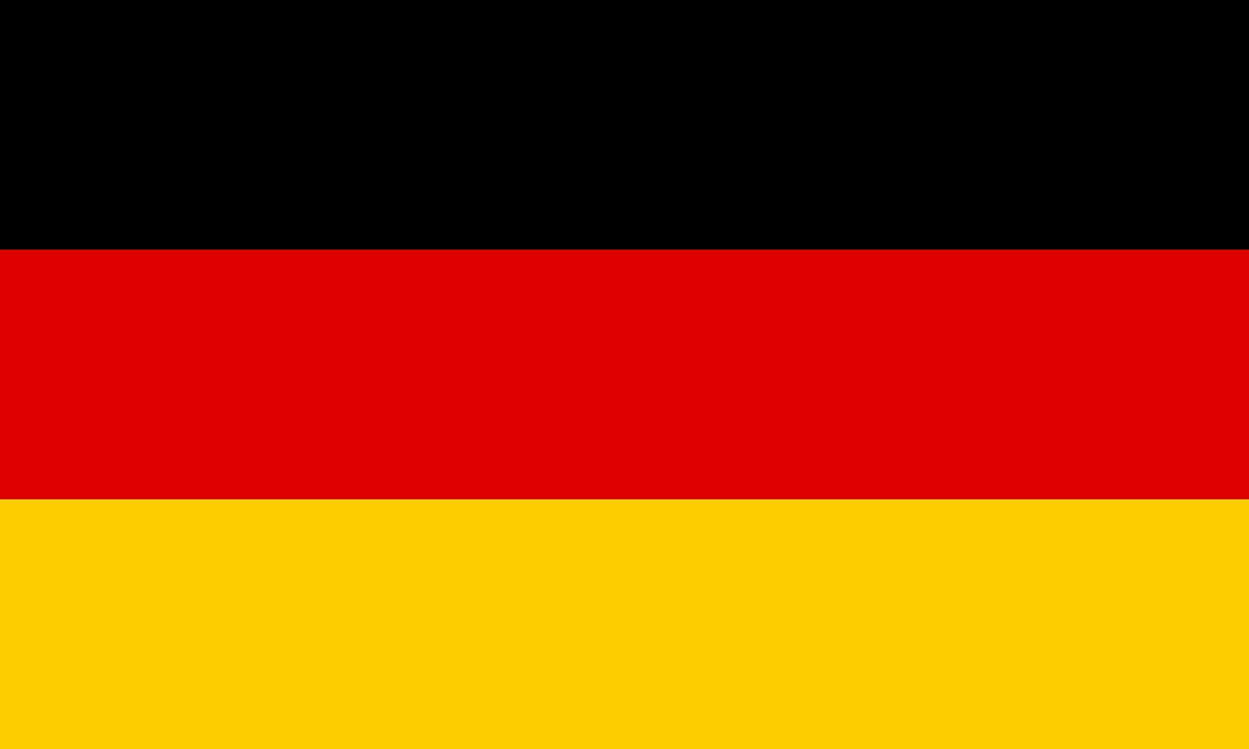
Graphic Organizer
The USSR was Germany’s main obstacle; Stalin might resist Hitler’s attempts to take possession of Poland
Stalin, on the other hand, was convinced that Hitler’s ultimate goal was to attack the USSR
Germany and the USSR signed a friendship and nonaggression treaty in August of 1939. This meant that Germany could now attack Poland without the interference of the USSR.
Germany promised that the USSR would receive parts of eastern Poland, Finland, Estonia and Latvia.

Slide 3
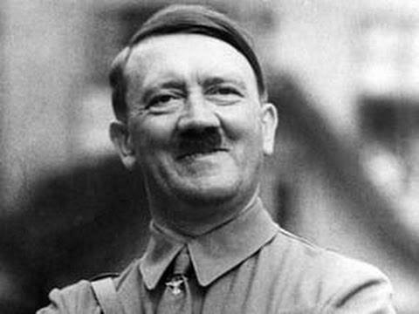
Graphic Organizer pt. 2
Although Stalin didn’t believe this, he needed time to build up his military, and he believed that he was outsmarting Hitler (“He thinks he’s outsmarted me, but actually it’s I who have tricked him.”)
With this treaty, Hitler was now assured that he could finally invade Poland. Despite Britain’s guaranteed support for Poland, Hitler believed that this was a bluff. But when German troops crossed the border into Poland, Britain and France declared war on Germany and WW2 begun.

Slide 4
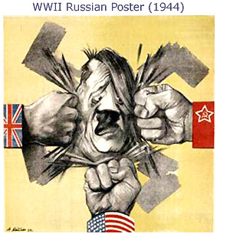
Key Dates
Germany and the USSR signed a treaty of friendship and nonaggression on 24 August 1939.
September 1 1939 German troops crossed the border into Poland
September 3rd, Britain declared war on Germany , France followed afterwards.

Slide 5
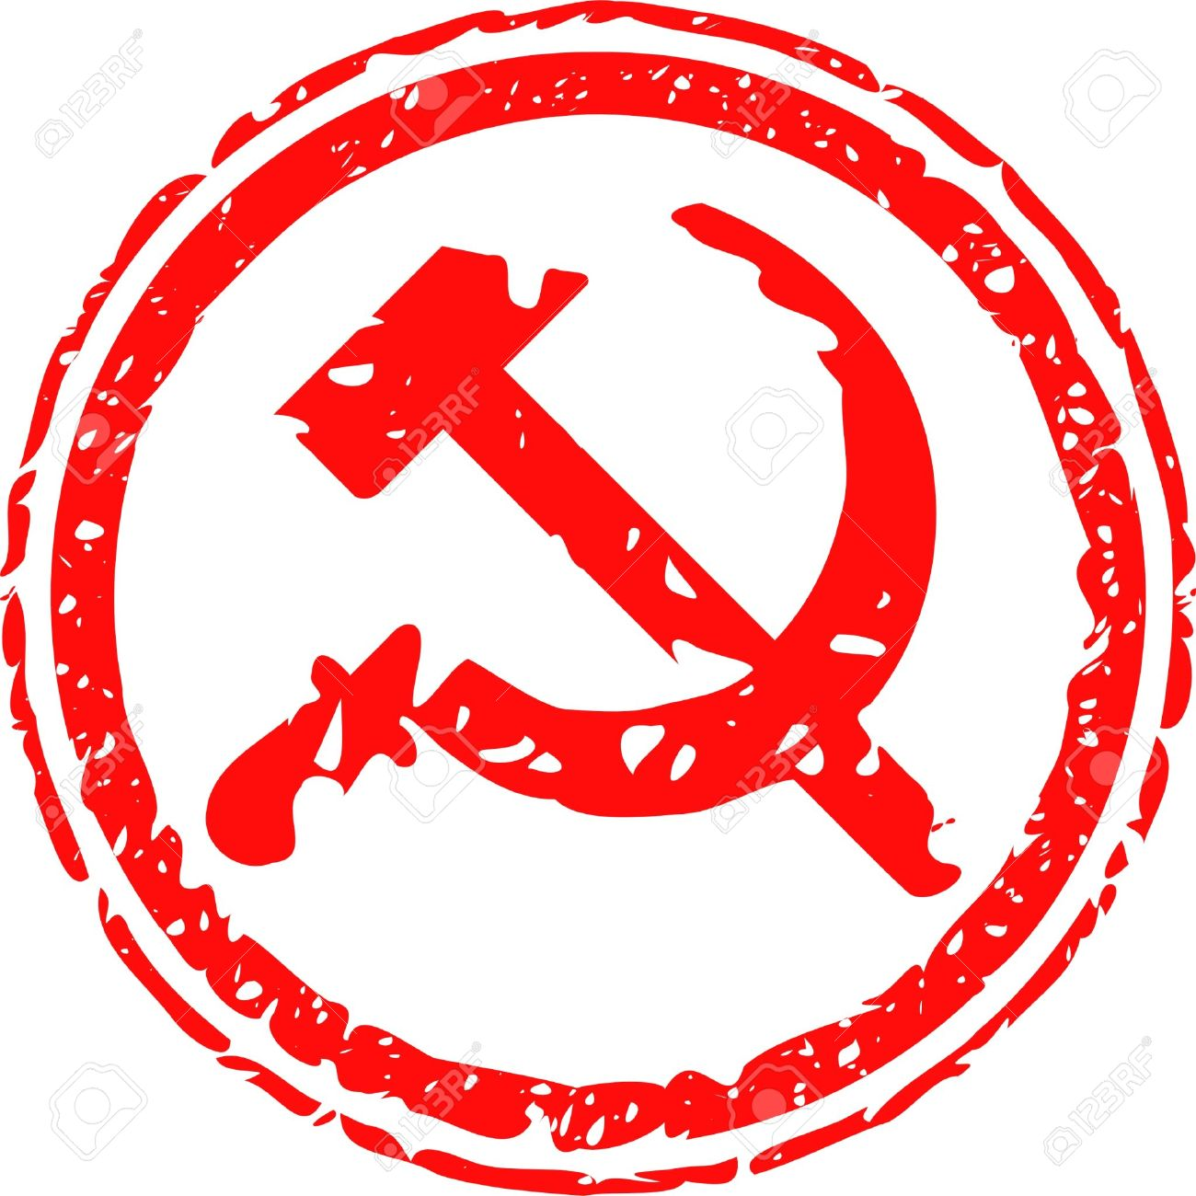
Vocabulary
Molotov-Ribbentrop Pact: Meant that Germany would be able to attack Poland without the interference of the USSR.
Communism: A way of organizing a society in which the government owns things that are used to make and transport products and there is no privately owned property.

Slide 6
Key People
Joseph Stalin was the Secretary of the Central Committee of Communist Party of the Soviet Union. Stalin was the man who granted Germany to invade Poland. Buying Stalin and the USSR some time to upgrade their military and prepare in case of another World War.
Adolf Hitler promised that the USSR would receive eastern parts of Poland,Finland, Estonia, and Latvia. Was believed that his intention was to attack the USSR, and an invasion of Poland could be seen as preparation for this.

