Slide 1
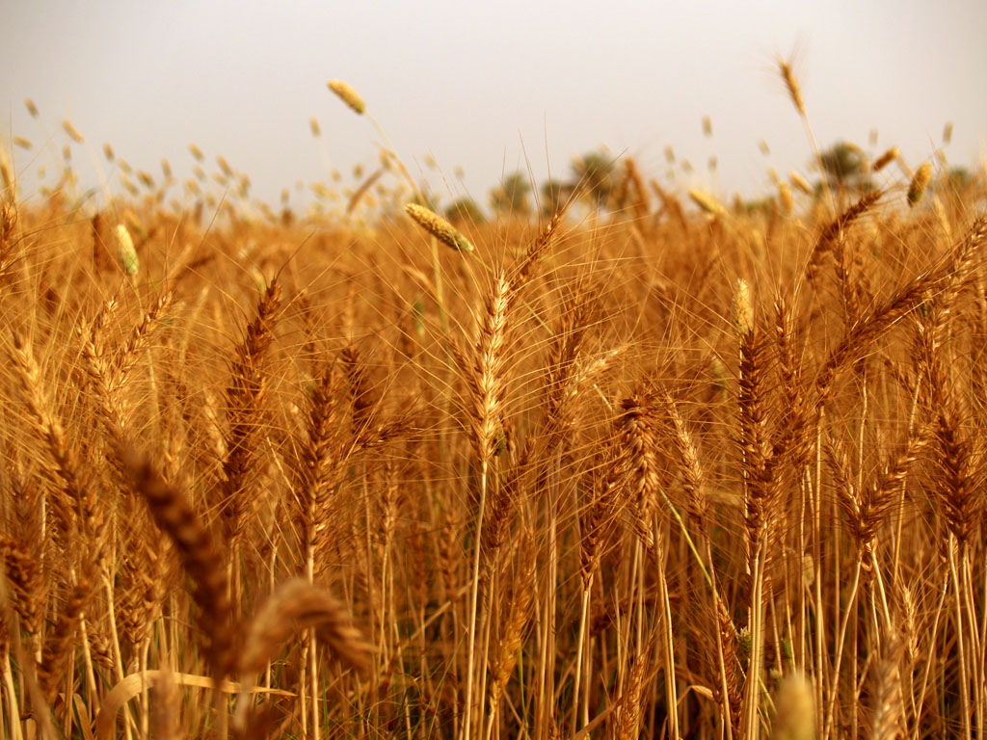
How did the Neolithic Revolution
transform human societies?

Slide 2
The history of the universe is greater than the history
of humanity. This “Cosmic History” or “Big History”
dates back to the Big Bang (around13.7 billion years ago)
and continues to the present.
The formation of the earth occurred around
4.5 billion years ago while the emergence of humans occurred only 2.5 million years ago.
Early humans originated in East Africa
Early humans migrated to different parts of the
world
Homo sapiens sapiens emerged about 120,000
years ago
There have been no major evolutionary changes
in the species since then

Slide 3
World Historians recognize three distinct phases
in the human journey:
The Paleolithic Era:
Literally means “Old Stone Age”
Gathering and hunting way of life
Represents over 95% of the human journey
The Neolithic Era:
About 12,000 years ago, agriculture was introduced
into some communities
Permanent settlements and specialization developed
The Industrial Era:
Beginning in England around 1750
The mechanization of agriculture and industry

Slide 4
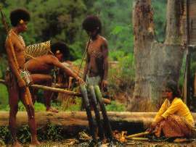
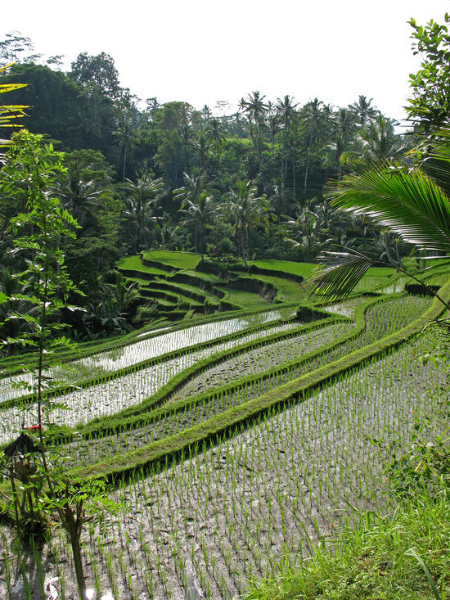
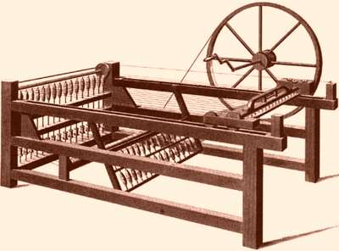

Slide 5
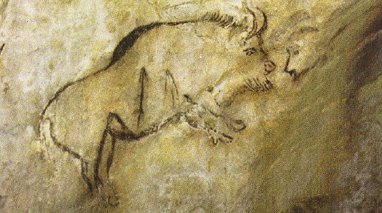
The Paleolithic Phase:
Gatherers and hunters
Organized often in small kinship groups
Highly mobile
Nomadic
Women, as gatherers, contributed significantly
to the food supply
Men as hunters contributed to the food supply
Some Paleolithic people made beautiful cave
paintings

Slide 6
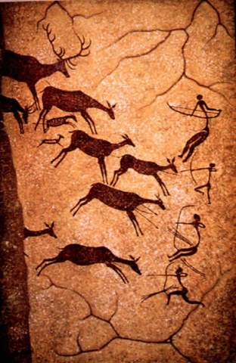
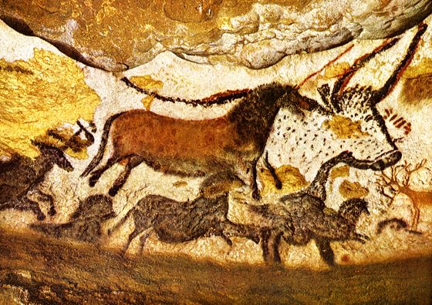

Slide 7
The Neolithic Period:
Around 12,000 years ago (10,000 – 9000 BCE),
some communities began to domesticate plants
and animals
Agriculture developed in at least three separate
places:
- The Northern Middle East/Black Sea
the domestication of wheat and barley
- South China and Continental Southeast Asia
the domestication of rice around 7000 BCE
- Central Mexico
the domestication of corn or maize around
5000 BCE around corn or maize

Slide 8
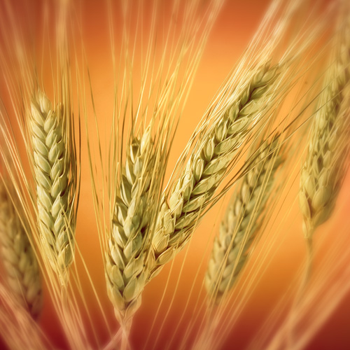
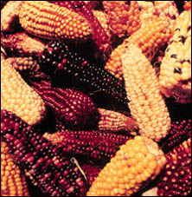

Slide 9
By 5000 BCE, agriculture gradually spread
and though it eventually became the dominant
mode of acquiring food, its adoption was slow.
Reasons for Gradual Adoption of Agriculture:
Contacts were minimal among populations
often separated by great distances
Not all areas were equally suited for agriculture
Some communities developed pastoralism or
herding as an alternative to settled agriculture
Not all communities were attracted to settled
life

Slide 10
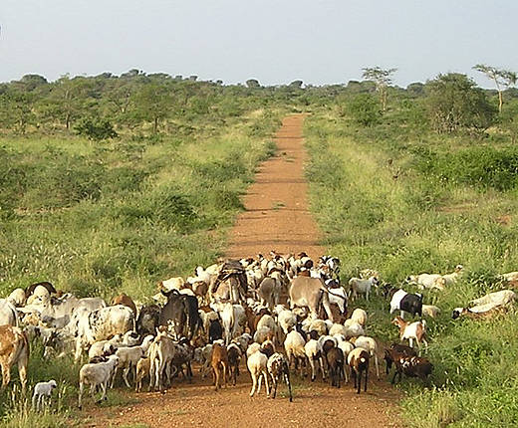

Slide 11
Agriculture’s Profound Changes:
Work increased – agriculture required more time
than hunting and gathering
Gender relationships changed as men were the
primary cultivators of staple food crops
Patriarchal cultures developed
Increased inequality in social relations
Increased exposure to diseases in settled societies
Increased negative impact to environment

Slide 12
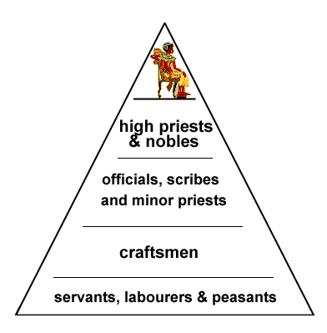
New Hierarchies Developed

Slide 13
Agriculture fundamentally changed human
societies:
Greatly increased food supplies
Allowed families to have more children
Population explosion occurred
Food surpluses allowed for specialization
Not all individuals were required for farming
- although early agricultural societies needed
large numbers of farmers
Cities eventually developed
Writing eventually developed

Slide 14
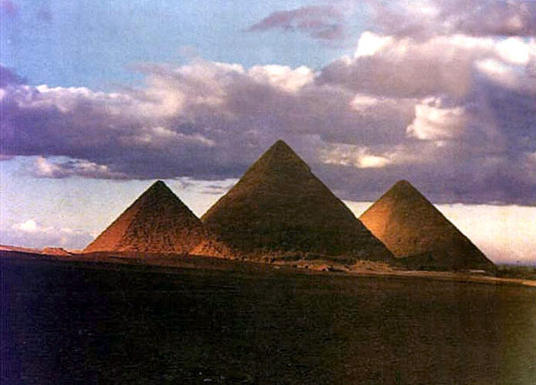

Slide 15
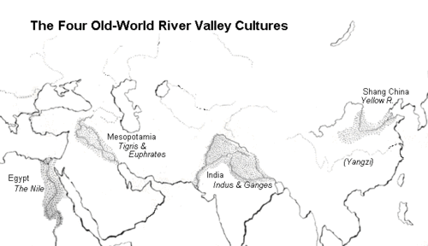

Slide 16
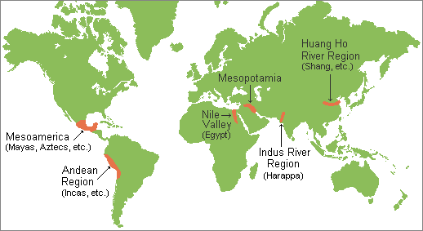

Slide 17
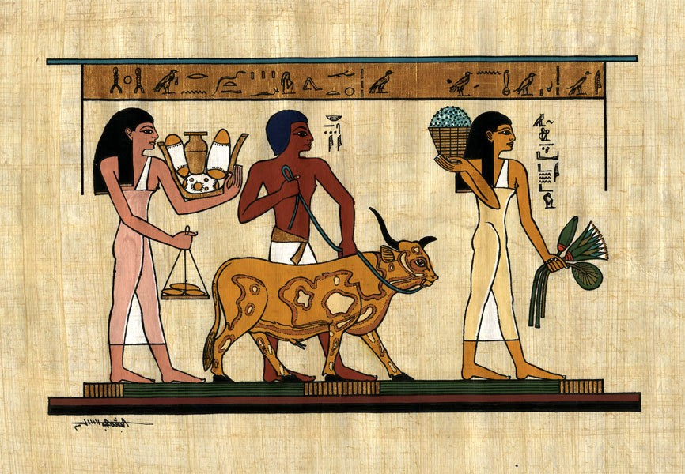

Slide 18
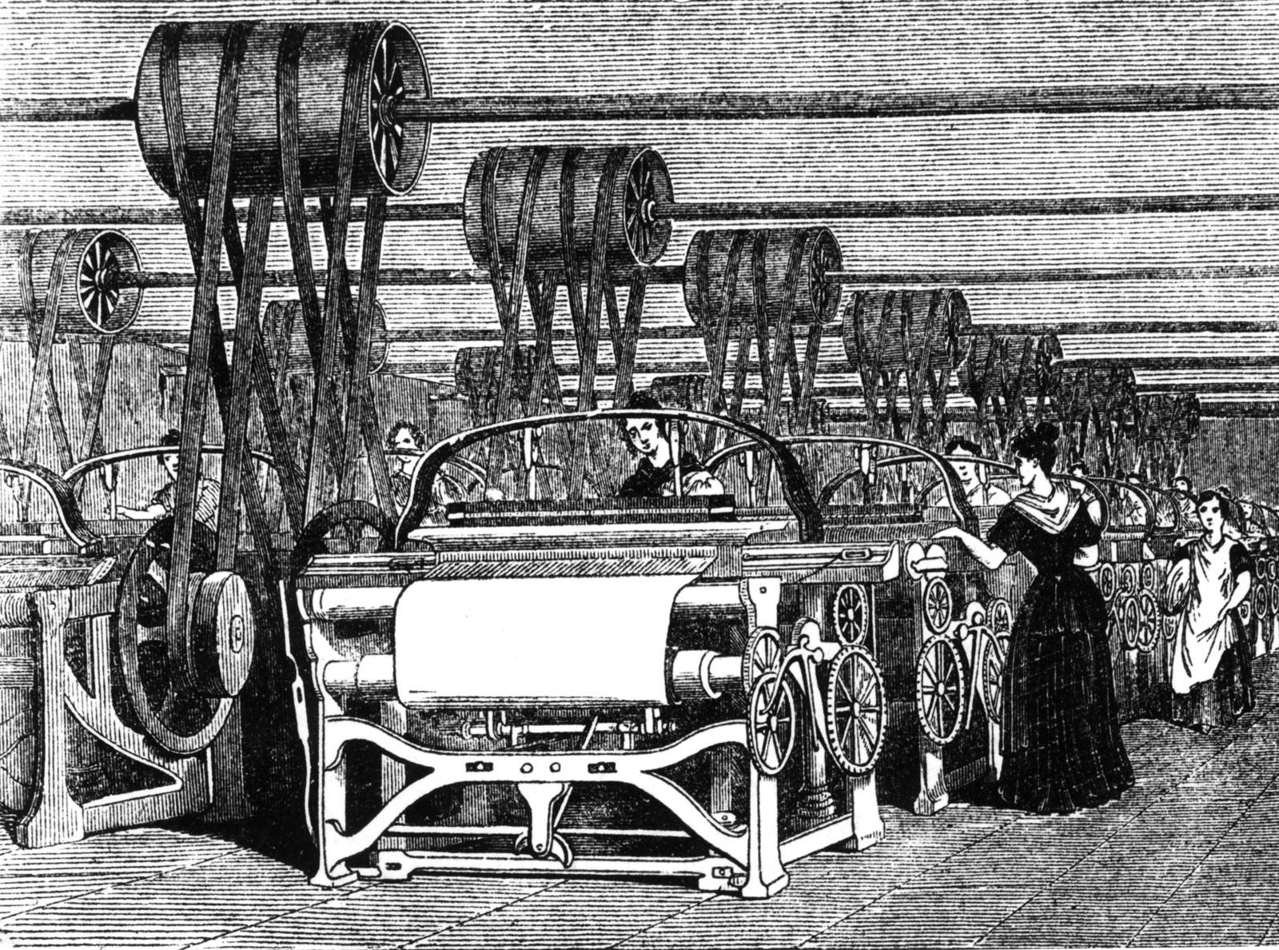
For many years, the Neolithic Revolution was
the most significant turning point but by 1750,
the Industrial Revolution began and like
the Neolithic Revolution, it spread and
radically altered human societies.

Slide 19
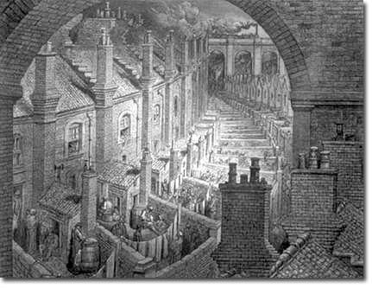
Like the Neolithic Revolution, the Industrial
Revolution had a profound impact on human
societies and the environment.

Slide 20
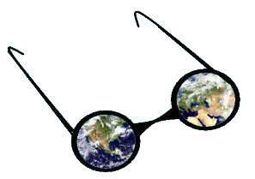
But changes are not just material, changes
are also changes in consciousness.
The Neolithic Revolution led humans to
pay greater attention to the seasons and
the forces of creation.
Changes occurred in the worldview of
farming communities.

Slide 21
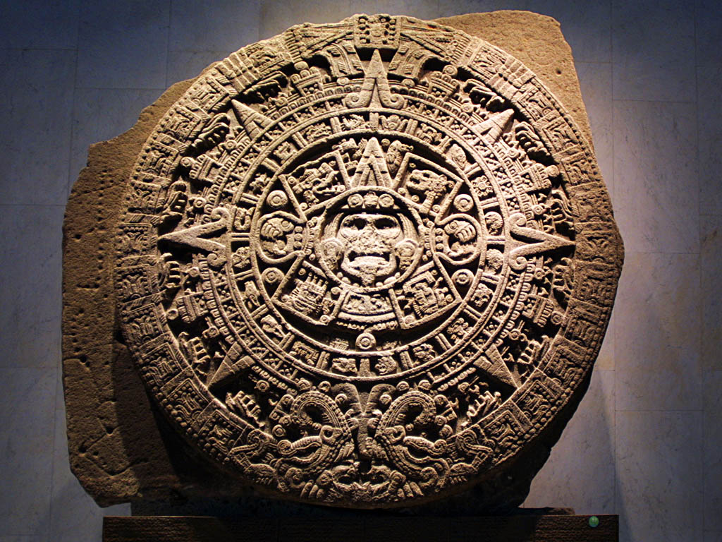

Slide 22
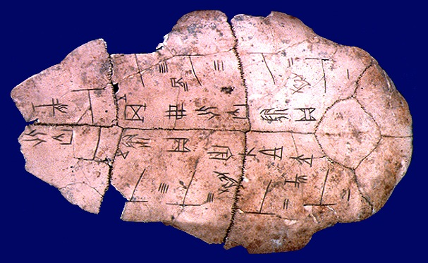

Slide 23
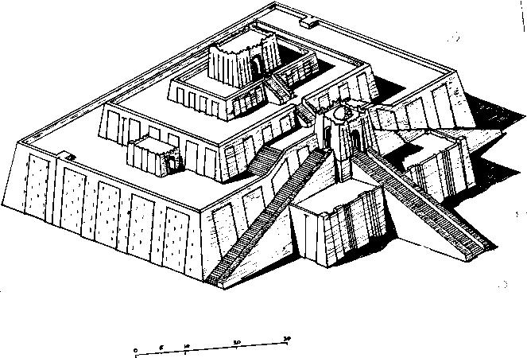

Slide 24
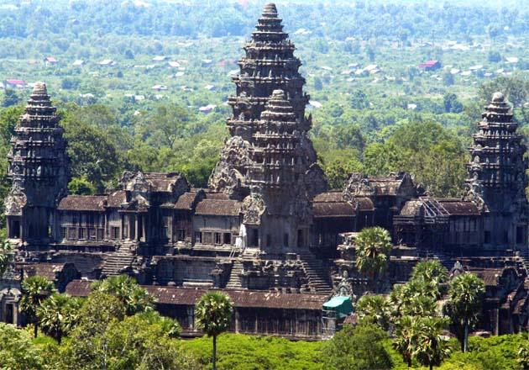

Slide 25
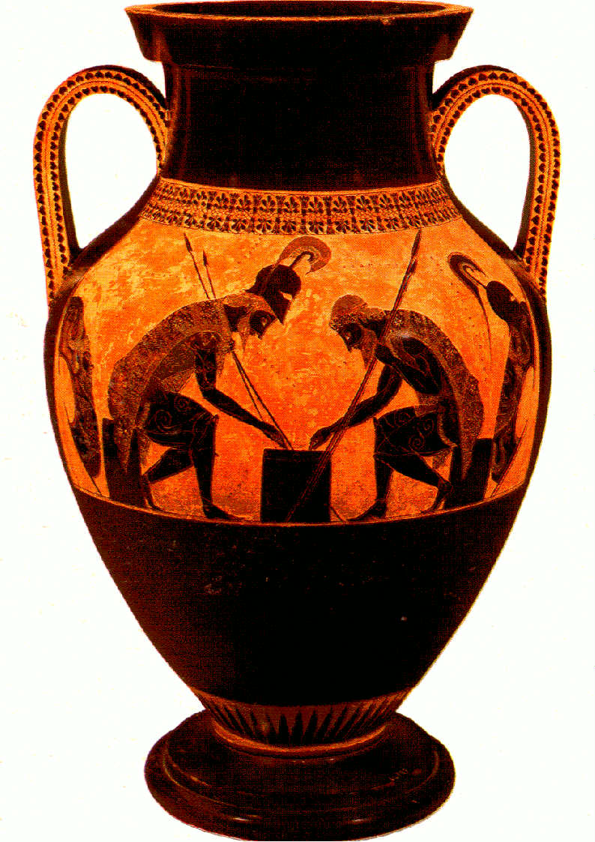

Slide 26
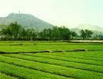
Questions:
Why is it important to consider Cosmic History
when studying the human journey?
What are three critical phases of the human journey?
What were the beneficial aspects of gathering
and hunting societies?
How did the introduction of agriculture transform
societies?
Why did agriculture spread if it was associated with
obvious disadvantages?
Assess the impact of industrialization. Why has
industrialization spread despite its disadvantages?

