Slide 1
Road to WWII - Key Players
Brianna Adan
Mark Dreitzler
Kelen Quintana
Brandon Regalado
Period 2

Slide 2
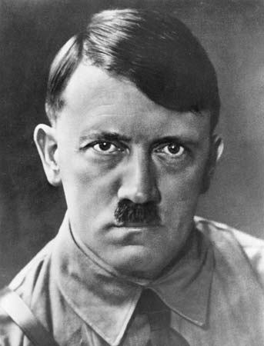
Adolf Hitler
Attempted a coup called the Beer Hall Putsch with the Nazi Party on Munich, Bavaria on November 8, 1923.
During his imprisonment for his attempted coup he wrote the “Mein Kampf”, gaining him popularity.
Became the Chancellor of Germany in January 1933 after gaining popularity due to the Wall Street crash and the worldwide economic depression. He called his government “The Third Reich”.
Hitler’s primary focus for his foreign policy was to destroy the Treaty of Versailles and to challenge other European countries.
In 1935 he began rearmament such as building up the Luftwaffe and introduced the policy of conscription.
Supported General Franco in the Spanish Civil War.
In 1938 he carried out the Anschluss, marking the invasion of Austria.
In 1938 he also demanded autonomy or self government for the German-speaking population in the Sudetenland, Czechoslovakia. Due to the policy of appeasement Britain and France were following towards Germany, they quickly agreed to the terms, signing the Munich agreement, causing Czechoslovakia to have no choice but to agree to hand over the Sudetenland.
In 1939 Hitler ordered the military to invade the capital of the Czech Republic, Prague.
In 1939 Ordered the invasion of Poland due to claims on the Danzig, German-speaking population. This was an act of defiance to the Polish-German non aggression treaty formed in 1934. This marked the start of World War II.

Slide 3
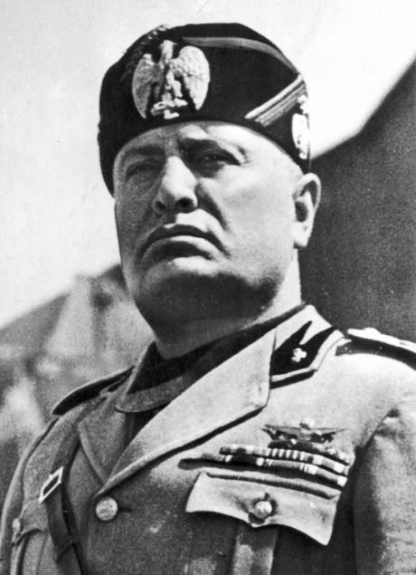
Benito Mussolini
Was formerly a teacher and journalist
Forged the paramilitary Fascist movement (called the Fascio Di Combattimento) in 1919-1921, using it to march on Rome, become prime minister, and then he seized dictatorial power (1925-1926)
Wanted to recreate the Roman Empire and restore Italy to its ‘Former Glory’
Practiced Totalitarianism, meaning that the interests of the state were more important than the interests of the individual.
Practiced Autarky, the idea that Italy should remain economically self sufficient.
In August 1923, Italy bombarded the island of Corfu in Greece. This became known as the Corfu Incident. .
Fiume was a joint city shared by Yugoslavia and Italy until the government under Mussolini reclaimed it in 1923. This was known as the Fiume incident.
In 1935, Mussolini ordered the invasion of Abyssinia, resulting in economic sanctions imposed by the League of Nations.
Due to these economic sanctions, Mussolini formed friendly terms with Hitler resulting in the Rome Berlin axis in 1936.
Mussolini joined the Anti-comintern pact in 1937 with Germany and Italy.

Slide 4
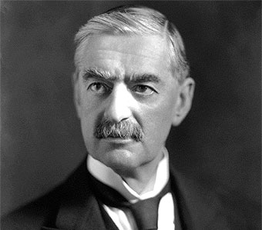
Neville Chamberlain
He was the British prime minister from 1937-1940.
Chamberlain was very well known for his policy of appeasement with Germany.
He tried to pacify Germany rather than incite them. This is possibly because at the time Germany was starting to outmatch Britain’s military.
He signed the Munich Agreement in 1938, giving up Czechoslovakia to the Nazis.
France and Britain agreed to protect Poland.
He declared war on Germany in 1939 when Germany invaded Poland.
By 1940, he resigned, as he lost much of his political support.

Slide 5
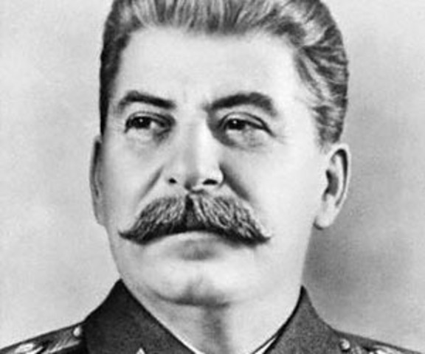
Joseph Stalin
Joseph Stalin was the dictator of the USSR in between the years of 1929 and 1953.
Stalin launched a series of five-year plans were intended to transform the USSR from a peasant society to an industrial superpower.
His plans centered around governmental control of the USSR’s economy and focused on taking farmland from farmers; although, many farmers refused to no avail.
Stalin ruled by terror with a totalitarian grip on the nation, and people feared Stalin very much.
His government was controlled by the Soviet Media.
He signed a non-aggressive pact with Germany.
He annexed many countries including: Poland, Romania, Estonia, Latvia and Lithuania

Slide 6
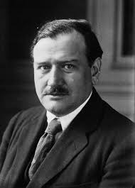
Édouard Daladier
French prime minister
Followed a policy of appeasement towards Germany, along with Neville Chamberlain.
Signed the Munich Pact with Britain on September 30 in an effort to avoid war, allowing Nazi Germany to take the Sudetenland without British or French opposition.
Declared war on Germany on September 3, 1939.
On October 6, 1939, Hitler offered France and the UK a peace proposal, but Daladier refused, saying, "[w]e took up arms against aggression. We shall not put them down until we have guarantees for a real peace and security, a security which is not threatened every six months."

Slide 7
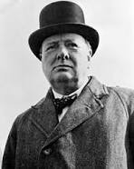
Winston Churchill
Became Prime Minister of Britain shortly after the start of WWII.
Leading advocate for British rearmament.
Criticized Neville Chamberlain’s policy of appeasement towards the Nazis.
He considered the Munich Agreement to be a major defeat.
Boosted morale during WWII at a time where Britain had a policy of appeasement.
He worked with Roosevelt and Stalin in shaping the allied strategy in WWII.
After the breakdown of the alliance, he alerted the West of the expansional threat of the Soviet Union.

Slide 8
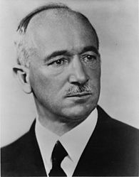
Edvard Benes
He was the Czechoslovakian president from 1935-1938 following the resignation of Masaryk.
Heavily influenced by nationalist, Tomáš Masaryk who wanted to liberate the Czechs and Slovaks from Austria.
He was the council chairman for the League of Nations 6 times.
He was influential in the Genoa and Locarno Conferences.
Had great opposition toward the German occupation of the Sudetenland.
In 1938 Mussolini, Hitler, Chamberlain, and Daladier agreed that Germany should take possession of the Sudetenland in the Munich Agreement.
Czechoslovakia was not invited to this meeting. Without any assistance from Britain or France, Benes had to abide by their decision. This marked his resignation causing him to be exiled.
Established a Czechoslovak provisional government on July 21, 1940, establishing closer relations with the Soviet Union.

Slide 9
Sources
http://www.history.com/this-day-in-history/britain-and-france-declare-war-on-germany
http://www.britannica.com/biography/Edouard-Daladier
http://www.britannica.com/biography/Winston-Churchill
http://www.biography.com/people/winston-churchill-9248164#world-war-ii
http://www.britannica.com/biography/Edvard-Benes
http://www.johndclare.net/RoadtoWWII1_BBCnotes.htm
http://ww2db.com/person_bio.php?person_id=530

