Slide 1
Poland in WW2
by: Isabel Cesarotti
Gina Milito
Steven Samosky
Bhavna Sriram

Slide 2
History of Poland
Poland was a successor state. This means that it was created from the broken up European empires after WW1 by the powers at the Paris peace settlement.
Poland had vast economic, social and political problems like all the other successor states as a result of their creation.
Of Poland’s 27 million population, only less than 18 million were Poles meaning more than 1 million were German-speakers.
Border disputes brought Poland into conflict with Czechoslovakia, Lithuania, Russia, and most importantly, Germany
Poland’s rough beginning laid the framework for its later role in history

Slide 3
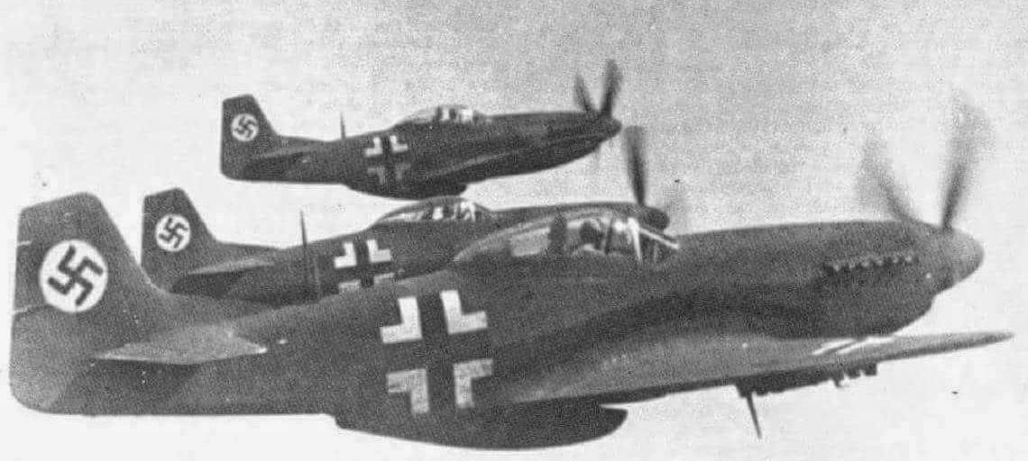
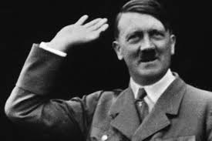
German Invasion of Poland
In April of 1939, Hitler demanded the return of Danzig and German access to the across the Polish Corridor.
Hitler’s interest in Danzig was the great amount of German speakers it held and it he no longer wanted the Polish Corridor splitting East Prussia from the rest of Germany.
August 24, 1939, Germany and Russia sign the Molotov-Ribbentrop Pact, otherwise known officially the Treaty of Nonaggression between Germany and the Union of Soviet Socialist Republics, which effectively keeps the USSR from getting in the way of invading Poland and Hitler promises Stalin some land in East Poland after Germany claims it as their own.
On September 1st, 1939, German troops begin their invasion and cross Polish Borders with more than 2,000 tanks and over 1,000 planes.
June 22, 1941, Germany defies and breaks the Molotov-Ribbentrop Pact when they attack the Soviet positions in Poland.
September 3, 1939, at 11 a.m. Britain declares war on Germany.

Slide 4
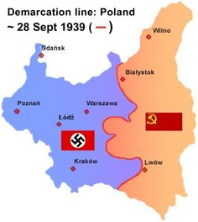
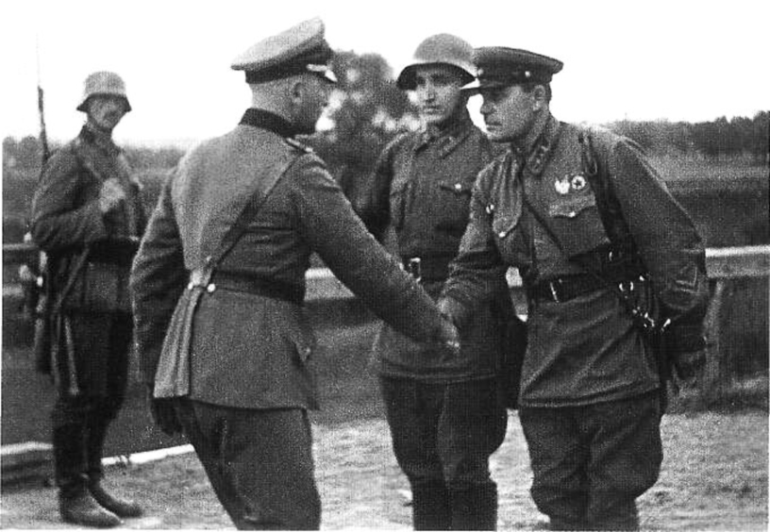
Soviet Union Invasion of Poland
On September 17, 1939, the Soviet army broke into the borders of Poland led by commanders Mikhail Kovalyov and Semyon Timoshenko
Result of the Molotov-Ribbentrop Pact (August 24, 1939) signed between Germany and the USSR, stating that Germany would invade Poland without USSR interfering
Government of Soviet Union took advantage of German invasion to violate the non-aggression pact
Declared they were trying to defend Ukrainian and Belarusian people while entering Polish territory
Crossed paths with German troops and made them recede back to the far east of Poland and hand over their Polish prisoners
Ended with ⅗ of Poland land and control over 13 million people

Slide 5
Poland’s Overall Significance in WW2
On September 1, 1939, Germany invaded Poland followed by the Soviet Union invading on September 19 starting World War II.
Poland was said to have the fourth largest Allied army in Europe, after the Soviet Union, United States, and Britain.
When Germany made the first move, Hitler was sure that the prior policy of appeasement was evidence enough that there would be no punishment.
Britain and France, standing by their guarantee of Poland's border, had declared war on Germany on September 3, 1939. The Soviet Union invaded eastern Poland on September 17, 1939.
Poland showed more resistance than France, who had prior warning of German aggression.
The Allies were of no help to aid Poland OR hinder Germany. Polish forces wanted to get the ball moving and created ideal conditions for the Allies to engage the German forces in the West.
The Allies didn’t take advantage of the situation presented but if they had, WW2 could have lasted a much shorter time.

