Slide 1
Chapter 12 Physical Geography of Europe: The Peninsula of Peninsulas
Because of its unique geography and weather patterns, Europe’s landscapes, waterways, and climates vary greatly.

Slide 2
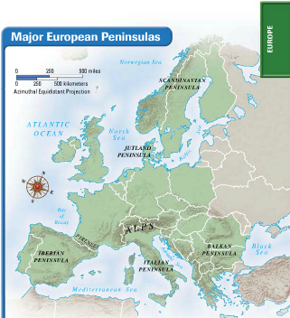
Section 1: Landforms and Resources
Section 2: Climate and Vegetation
Section 3: Human-Environment Interaction

Slide 3
Section 1: Landforms and Resources
• Europe is composed of many peninsulas and islands.
• Europe’s landforms also include large plains and mountain ranges.

Slide 4
Section 1: Landforms and Resources
Peninsulas and Islands
Always Near the Water
• Europe is a large peninsula off of Asia
- also has its own smaller peninsulas: a “peninsula of peninsulas”
- most places are within 100 miles of the ocean or a sea

Slide 5
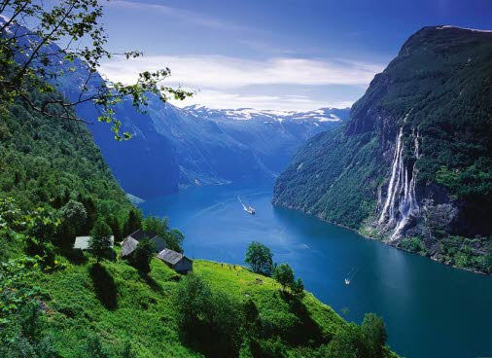
Continued Peninsulas and Islands
Northern Peninsulas
The Scandinavian Peninsula includes Norway and Sweden
bounded by Norwegian, North, and Baltic Seas
Ice Age glaciers remove topsoil; leave thin, rocky soil
Glaciers create fjords in Norway
steep U-shaped valleys connected to sea, filled with seawater
provide harbors for fishing boats
Jutland Peninsula forms large part of Denmark, small part of Germany
gentle, rolling hills and swampy low areas

Slide 6
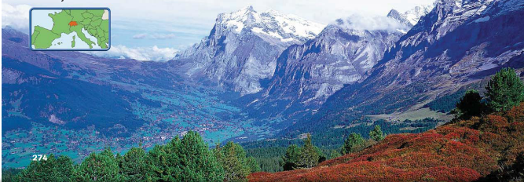
Mountains and Uplands
Mountain Chains
The Alps is Europe’s most famous mountain chain
crosses France, Italy, Germany, Switzerland, Austria, Balkans
cuts Italy off from rest of Europe
Pyrenees block movement from France to Spain and Portugal
Apennine Mountains divide Italian Peninsula between east, west Balkan Mountains block off peninsula, separate ethnic groups

Slide 7
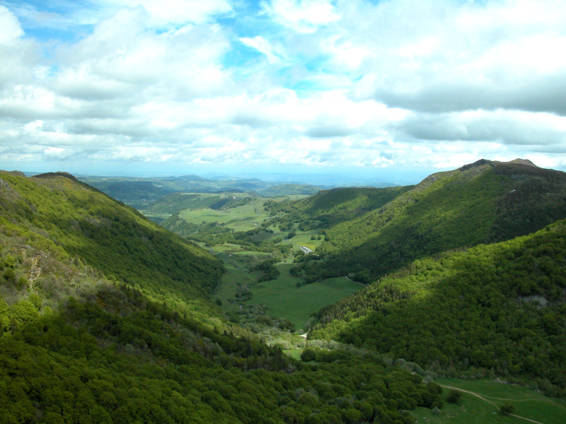
Continued Mountains and Uplands
Uplands
Uplands—hills or low mountains; may have mesas, high plateaus
some are eroded remains of mountain ranges
Uplands include Scandinavian Kjolen Mountains, Scottish Highlands
Also Brittany in France and the Meseta plateau in Spain
Some uplands border mountainous areas
Central Uplands of Germany at base of Alps
Massif Central uplands in France

Slide 8
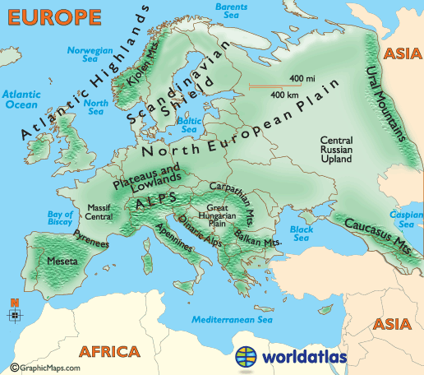
Rivers: Europe’s Links
Moving People, Goods, Ideas
Network of rivers bring people, goods together
allows goods inland from coastal harbors, aids economic growth
Two major, castle-lined rivers have historically acted as highways
Rhine flows north 820 miles from interior to North Sea
Danube flows east 1,771 miles, through 9 countries, to Black Sea
These and many other rivers connect Europeans
encourage trade and travel

Slide 9
Fertile Plains: Europe’s Bounty
The Northern European Plain
One of the most fertile agricultural regions in world
Curves across France, Belgium, Netherlands, Denmark, Germany, Poland
flat agricultural land produces vast quantities of food
Flatness also has given invaders an open route into Europe
Other, smaller, fertile farming plains:
Sweden, Hungary, northern Italy’s Lombardy

Slide 10
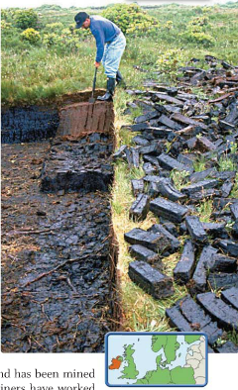
Resources Shape Europe’s Economy
Fueling Industrialization
Coal and iron ore are needed to create steel for industrialization
found in Belgium, Netherlands, France, Germany, Poland
Major industrialized regions:
Ruhr Valley, Germany; parts of United Kingdom

Slide 11
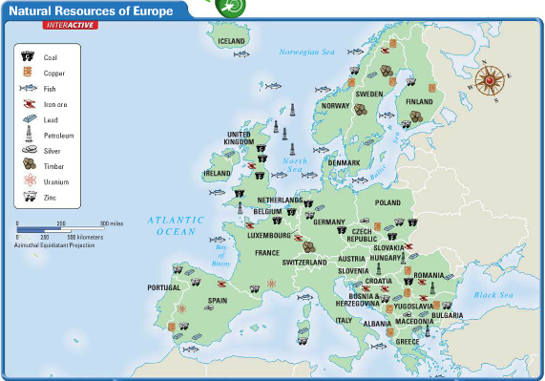
Continued Resources Shape Europe’s Economy
Energy
Oil, natural gas found in North Sea in 1959; offshore rigs in 1970s
petroleum supplied by Norway, Netherlands, Britain
Agricultural Land
33% of Europe is suitable for agriculture; world average only 11%

Slide 12
Resources Shape Life
Affecting All Parts of Life
Resources affect food, jobs, houses, even culture
for example, folk tales set in deep, dark forests of Old Europe
Distribution of resources creates regional differences
for fuel, Irish burn peat—partially decayed plant matter from bogs
Polish miners have worked coal mines for generations

Slide 13
Section 2: Climate and Vegetation
• Much of Europe has a relatively mild climate because of ocean currents and warm winds.
• Eastern Europe has a harsher climate because it is farther from the Atlantic Ocean.

Slide 14
Section 2: Climate and Vegetation
Westerly Winds Warm Europe
A Mild Climate for a Northern Latitude
Marine west coast climate: warm summers, cool winters
Spain, France, Poland, British Isles, coastal Scandinavia
North Atlantic Drift—current of warm water from the tropics
prevailing westerlies carry current’s warmth, moisture inland
Alps’ high elevation creates colder climate, deep winter snows

Slide 15
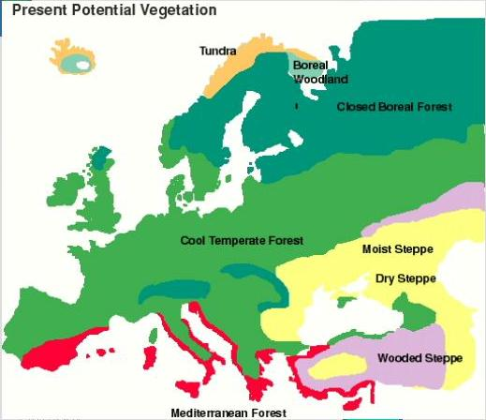
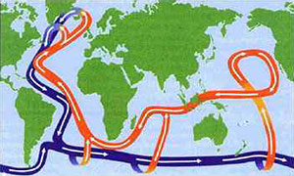
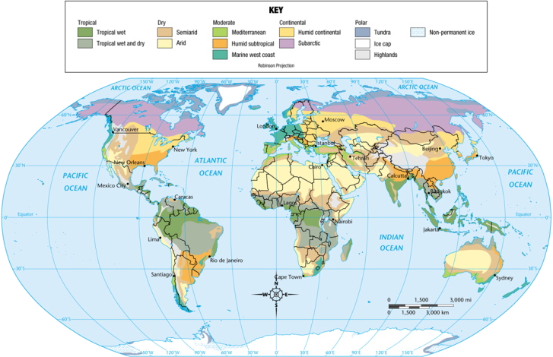
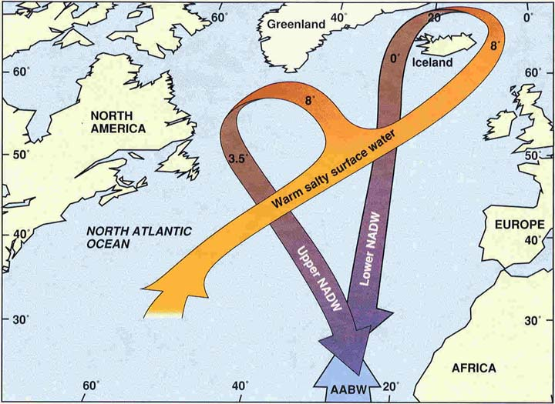
Section 2: Climate & Vegetation
North Atlantic Drift- current of warm water from the tropics
Prevailing westerlies pick up warmth from this and helps give Europe a mild climate

Slide 16
Continued Westerly Winds Warm Europe
Forests to Farms
Original mixed forests cleared for farming
grow grains, sugar beets, livestock feed, potatoes

Slide 17
Harsher Conditions Inland
Not Reached by Westerly Winds
Humid continental climate: cold, snowy winters; warm or hot summers
Sweden, Finland, Romania; eastern Poland, Slovakia, Hungary
Adequate rainfall for agriculture
Heavy deforestation; surviving trees are mostly coniferous
Broad, fertile plains were once covered with grasses
today, wheat, rye, barley, potatoes, sugar beets grow

Slide 18
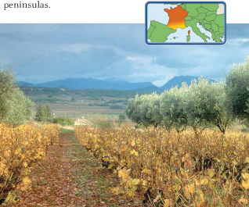
The Sunny Mediterranean
An Appealingly Mild Climate
Mediterranean climate: hot, dry summers; mild, wet winters
Italy, Greece and southern Spain, France
mountain block cold north winds
Special Winds
Mediterranean coast of France is not protected by mountains
mistral—a cold, dry winter wind from north
Sirocco—hot North African wind carries sea moisture or desert dust

Slide 19
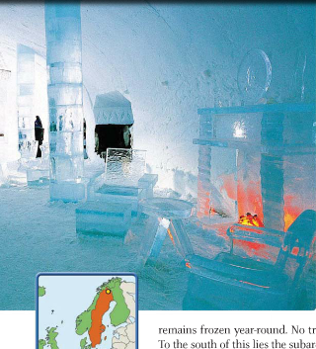
Land of the Midnight Sun
Cold, Dark Winters
Tundra climate in far northern Scandinavia, along Arctic Circle
permafrost with no trees, only mosses, lichens
South of tundra is subarctic climate: cool with cold, harsh winters
little growth except stunted trees
Region’s sunlight varies sharply: long winter nights, summer days
area north of Arctic Circle the “Land of the Midnight Sun”
some winter days have no sun, some summer days have no night

Slide 20
Section 3: Human-Environment Interaction
• The Dutch and the Venetians altered lands to fit their needs by constructing polders and canals.
• Uncontrolled logging and acid rain destroy forests.

Slide 21
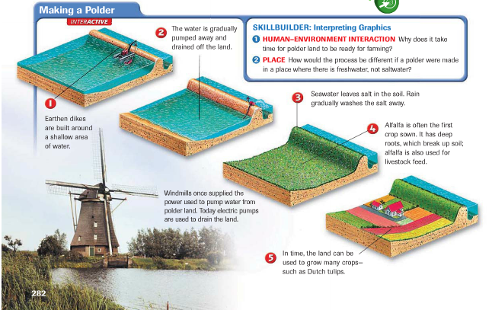
Section 3: Human-Environment Interaction
Polders: Land from the Sea
Creating Holland
“God created the world, but the Dutch created Holland”
to hold growing population, the Dutch reclaimed land from the sea
40% of the Netherlands was once under water
dikes—earthen banks that hold back the sea
polder—land reclaimed by diking and draining

Slide 22
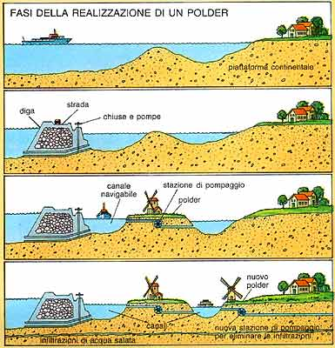
Section 3: Human-Environment Interaction
Dikes- earthen banks
Polder- land that is reclaimed from the sea by diking and draining the water.

Slide 23
Continued Polders: Land from the Sea
Seaworks
Seaworks—structures like dikes that control sea’s destructive force
terpen—high earthen platforms that provide safe ground during floods
In 1400s windmills were used to power pumps that drained land
today the pumps are powered by electricity

Slide 24
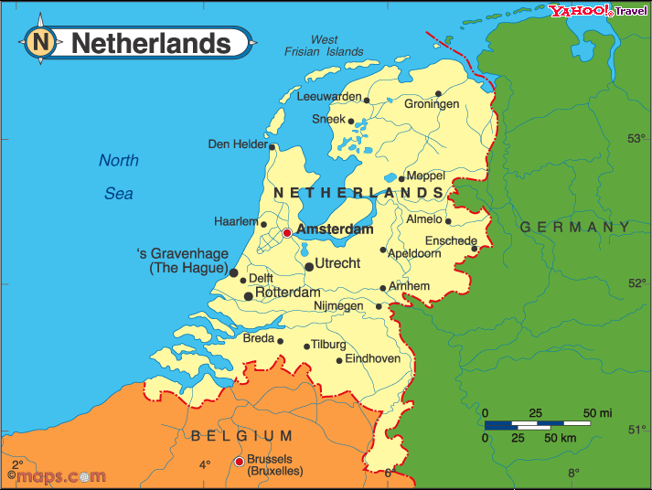
Continued Polders: Land from the Sea
Transforming the Sea
Zuider Zee—arm of North sea the Dutch turned into a fresh-water lake
Built dikes across entrance in early 1900s
saltwater eventually replaced by fresh water
Project added hundreds of square miles of land to the Netherlands
lake is now called Ijsselmeer

Slide 25
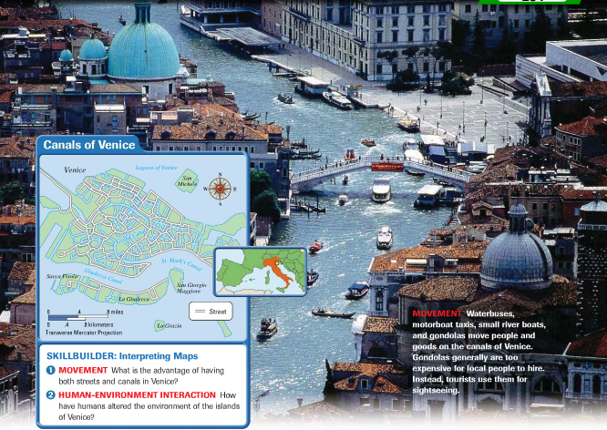
Waterways for Commerce: Venice’s Canals
An Island City Grows
City of Venice is made up of 120 islands
two of the largest are San Marco and Rialto
People, goods are moved by boat over 150 canals
City forms when people escaping invaders settled on lagoon islands
location at north end of Adriatic makes it a good trading port

Slide 26
Continued Waterways for Commerce: Venice’s Canals
Building on the Islands
Builders sunk wooden pilings into swampy land to support buildings
oak forests in northern Italy and Slovenia were leveled for pilings
Weight of buildings is compressing ground, so Venice is slowly sinking
Rising sea levels and removal of groundwater also cause sinking

Slide 27
Continued Waterways for Commerce: Venice’s Canals
Problems Today
Severe water pollution
industrial waste, sewage, saltwater eat away foundations
erosion lets saltwater in, creates floods such as in 1966
Agricultural runoff promotes “killer algae” growth
algae grow rapidly, die, decay; this uses up oxygen, so fish die
dead fish attract insects and create stench in warm weather

Slide 28
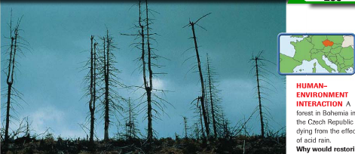
A Centuries-Old Problem: Deforestation
The Demand for Wood
Huge areas of Europe fall prey to deforestation
Wood used for fuel, building material for ships, houses
industry needed wood charcoal for blast furnaces
eventually coal replaces wood, but damage to forests is done

Slide 29
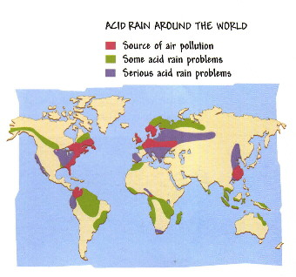
Continued A Centuries-Old Problem: Deforestation
Acid Rain Strips Forests
In 1960s Germans notice Black Forest trees are discolored, dying
cause is acid rain
Factories produce sulfur dioxide, nitrogen oxide emissions
combine with water vapor, create acid rain or snow
winds carry emissions to other areas, affecting one-fourth of forests
Scandinavia suffers heavily due to prevailing winds

