Slide 1
North America
Settler Colonies

Slide 2
http://www.fordham.edu/Halsall/mod/1585haies-gilbert.asp
http://www.fordham.edu/Halsall/mod/1650bradford.asp

Slide 3
Social
Because Britain, France, and the Dutch had socially mobile societies entrepreneurs were free to develop joint stock companies.
The Protestant work ethic and entrepreneurial spirit leads Europeans to set up permanent settlements in North America.

Slide 4
Political
France colonized parts of Canada and the Louisiana Territory
Dutch established fur trading posts in Eastern Canada and North Eastern US
British Colonized New England, New York, Pennsylvania
England ends up having the biggest impact on North America because it’s a changing society that had religious pluralism, a merchant capitalist classes, parliamentary government, and social mobility.

Slide 5
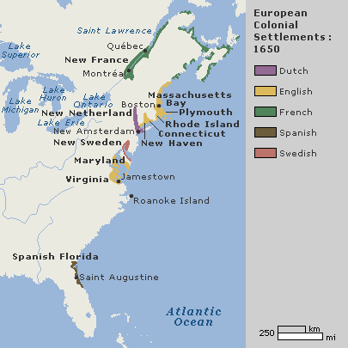

Slide 6
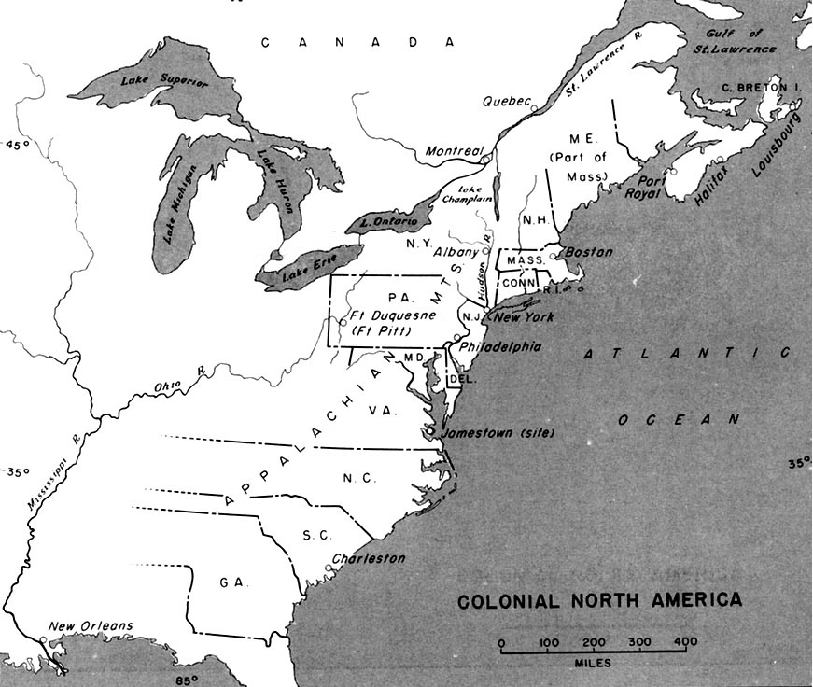

Slide 7
Impact on Environment
Land shortages in Europe resulting from the population boom from the Colombian Exchange led to a large amount Europeans seeking land, labor, and opportunities in North America. These people came to the new world to live permanently .
Native populations were effected by “Great Dying” but to a lessor extent than South America because the population density in North America was much less.
Fur bearing animals were pushed to near extinction from the Fur Trade ex. Beaver

Slide 8
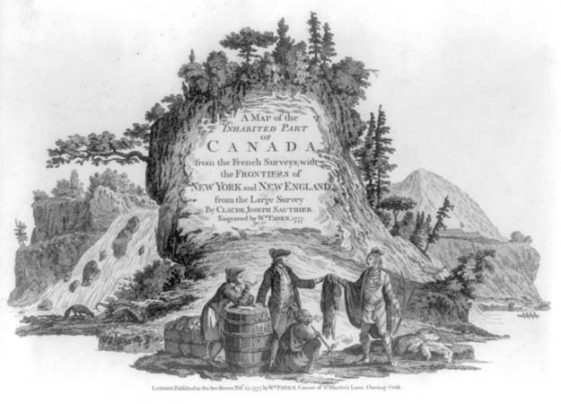

Slide 9
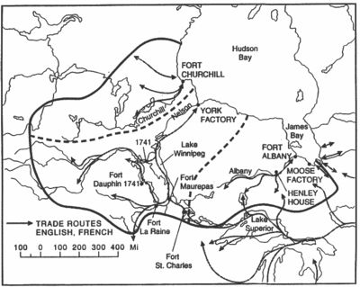

Slide 10
Culture
Puritans in Massachusetts and Quakers in Pennsylvania come to the New World to create new religious societies.
Many of the settlers in North America were Protestants and as a result literacy rates in North America are much higher than South America

Slide 11
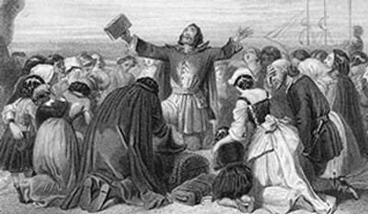
Puritans

Slide 12
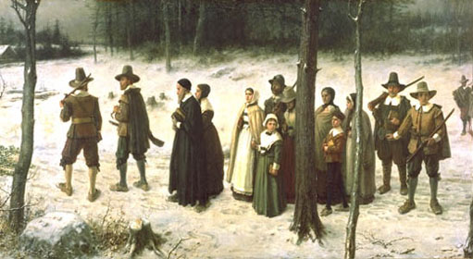

Slide 13
Economics
Fur Trade and small scale agriculture was prevalent in North America
Joint Stock Companies by the British and the Dutch were used to set up trading posts, explore uncharted territories, and establish settlements.

Slide 14
