Slide 1
The League of Nations
Its Origins and Aims

Slide 2
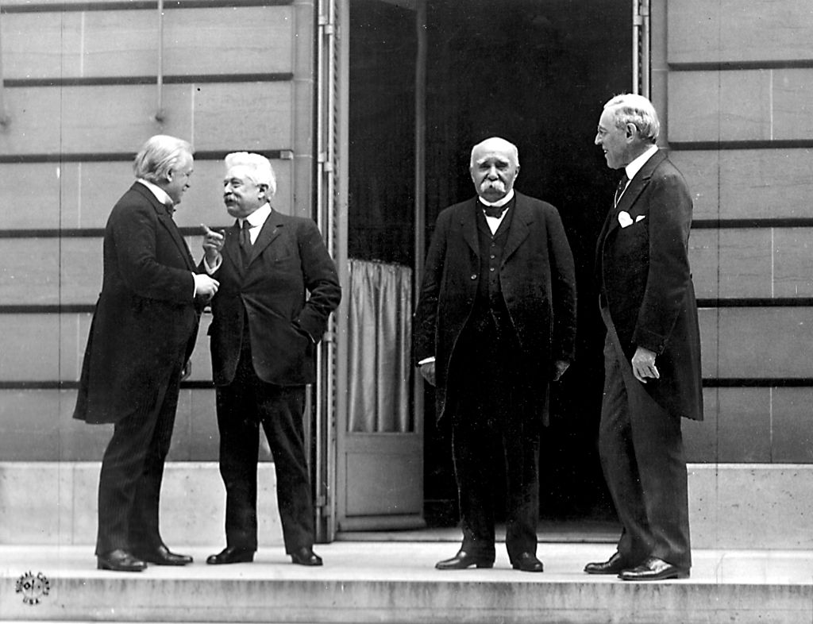
Wilson and his Fourteen Points
A general association of nations must be formed under specific covenants for the purpose of affording mutual guarantees of political independence and territorial integrity to great and small states alike – US President Woodrow Wilson in his “Fourteen Points” speech, January 1918
covenants – Binding agreements made between nations

Slide 3
So, how did the “League” begin?
Wilson included the idea in his Fourteen Points
…but….
1915 – The League to Enforce Peace (LEP) proposed an international agreement
Participating nations would agree to “jointly use their economic and military force against any one of their number that goes to war or commits acts of hostility against another.”
1915 – British League of Nations is founded
Notes:
During WWI, the sentiment that it was the “war to end all wars” had already began to spread around the globe
LEP began in NY by notable US citizens, including former US President William Howard Taft.
LEP made its proposal in 1915 at a conference in Philadelphia

Slide 4
Other’s had the idea, too!
1916 – senior British politician Lord Robert Cecil submitted a memo to the government, advocating:
An international organization to settle future disputes between nation-states
Help preserve world peace
Leon Bourgeois (France) and Paul Hymans (Belgium) made similar proposals to their governments
Jan Smuts (South Africa) published a treatise called “The League of Nations: A Practical Suggestion”
Notes:
Leon Bourgeios (France) and Paul Hymans (Belgium) represented their governments at the Paris Peace Conference
Smuts had argued in favor of more lenient terms for Germany in the Treaty of Versailles

Slide 5
Well, why do people think it’s Wilson’s idea?
Wilson becomes one of the biggest supporters of the idea for the League of Nations
Was chairman of a multinational commission set up to agree on the precise wording of the League of Nations’ Covenant
The commission included 2 representatives each from: USA, UK, France, Italy, and Japan
The commission included 1 representative each from: Belgium, China, Portugal, and Serbia
Later, Czechoslovakia, Greece, Poland, and Romania were added

Slide 6
Wilson – the League’s Champion!
Wilson insisted that each of the peace treaties from the conference include the League of Nations’ Covenant (yes, there were other treaties besides the Treaty of Versailles)
Embarked on an grueling tour of the US to promote and convince the US public about the League of Nations’ importance
Wilson will be awarded the Nobel Peace Prize in 1919 for his role in establishing the League of Nations
Notes:
Wilson was in failing health when he toured the US
Had to emphasize its importance both to the US and to the International Community
Wilson had stroke while touring the US in promotion of the League

Slide 7
It’s your birthday!
The League of Nations formally established by Part 1 of the Treaty of Versailles on June 28, 1919
42 nation-states became the founding members

Slide 8
The “cool” 42
Argentina
Australia
Belgium
Bolivia
Brazil
Canada
Chile
China
Colombia
Cuba
Czechoslovakia
Denmark
El Salvador
France
Greece
Guatemala
Haiti
Honduras
India
Italy
Japan
Liberia
The Netherlands
New Zealand
Nicaragua
Norway
Panama
Paraguay
Persia
Peru
Poland
Portugal
Romania
Siam
Spain
Sweden
Switzerland
South Africa
United kingdom
Uruguay
Venezuela
Yugoslavia

Slide 9
THE HIGH CONTRACTING PARTIES,
In order to promote international co-operation and to achieve international peace and security
By the acceptance of obligations not to resort to war,
By the prescription of open, just and honorable relations between nations,
By the firm establishment of the understandings of international law as the actual rule of conduct among Governments, and
By the maintenance of justice and a scrupulous respect for all treaty obligations in the dealings of organized peoples with one another,
Agree to this Covenant of the League of Nation
The opening section of the League of Nations’ Covenant

Slide 10
The Aims of the League of Nations
Preventing future war
Administering the post-war peace settlements
Promoting international co-operation

Slide 11
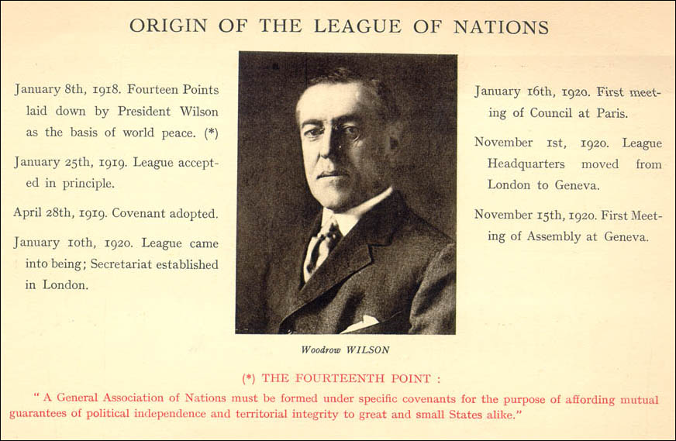
Origin of the League of Nations

Slide 12
Preventing Future Wars
Many of the leaders believed that the first war could have been avoided if there had been an international organization designed to settle disputes between nations.
The League was intended to make sure the Great War was the “war to end all wars”

Slide 13
Preventing Future Wars – How?
By promoting disarmament(Article 8)
By abolishing secret diplomacy (Article 18)
By member states agreeing to the League of Nations arbitration of any dispute between them (Article 13)
By developing the notion of collective security (Article 16)

Slide 14
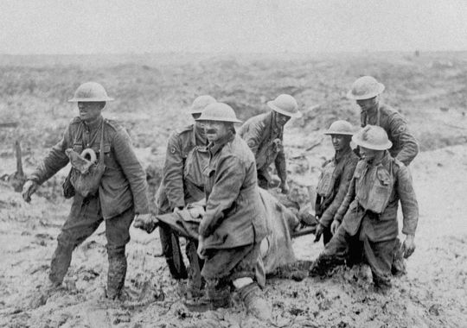
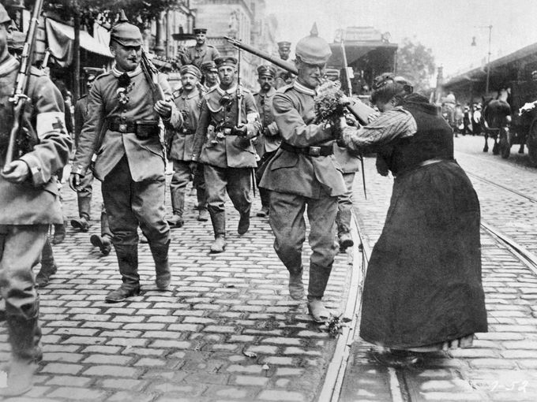
Disarmament
“Members of the League recognize that the maintenance of peace requires the reduction of national armaments to the lowest point consistent with national safety.”

Slide 15
Secret Diplomacy
Wilson strongly believed that the main cause of World War I was the secret diplomacy that had led to the Triple Alliance and Triple Entente
Any future treaty agreed upon by member states had to be registered with and published by the League of Nations
Notes:
Remind the students that the Triple Alliance and Triple Entente weren’t just 2 agreements, but a series of agreements made for defensive purposes over a period of time that not everybody was entirely aware of all of the details of each of the agreements.

Slide 16
Arbitration
arbitration – Mediation between opposing sides in a disagreement.
The League of Nations would investigate the dispute and consider the rights and wrongs of each party.
The League would pass judgment on how the dispute should be settled.
The League’s decision would be binding on both parties

Slide 17
Collective Security
Member states of the League of Nations would work together against any country:
Whose actions were seen as a threat to peace by acting aggressively
Ignoring decisions made by the League of Nations
Penalties could include:
economic sanctions – Refusing to trade with a nation that was acting in defiance of the League’s judgments
Joint military action

Slide 18
Administering the post-war peace settlements
Two major ways the League of Nations would ensure the peace settlements of the Paris Peace Conference were carried out:
Plebiscites
Mandates
The Saar Valley situation is an example of a plebiscite situation – The League of Nations controlled the area for 15 years and then the people got to decide in 1935 if they were part of France or Germany

Slide 19
Mandates
Defeated countries lost their colonies as a result of many of the treaties
Many of the colonies, though, were not ready for full independence
Former colonies would be run as mandates
Mandates – territory entrusted to another country (known as the Mandatory) appointed by the League of Nations
The Mandatories would submit annual report to the Mandate Commission and it would review the progress of the mandates territory

Slide 20
Three Classes of Mandates
Class A mandates – almost ready for independence
Mandatory was to provide administrative advice
Examples include Mesopotamia (Britain) and Syria (France)
Class B mandates – required a greater degree of control
Mainly the former African colonies of Germany
Class C mandates – essentially continue as colonies
“best administered under the laws of the Mandatory as integral portions of its territory”
Examples include South-West Africa and some South Pacific Islands

Slide 21
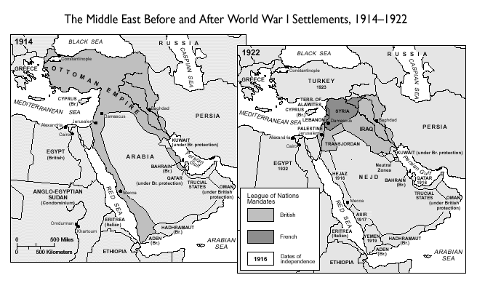

Slide 22
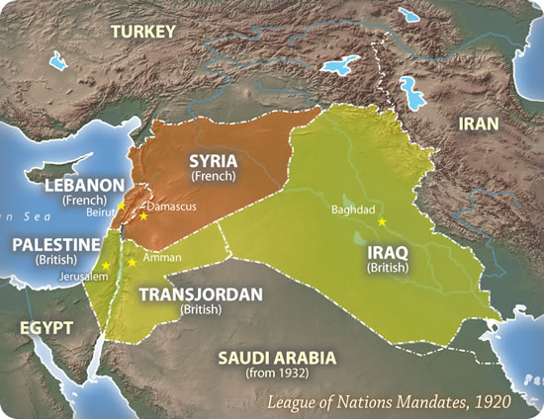

Slide 23
Promoting international cooperation
Actively work towards improving relations between member nations and their citizens:
by seeking to improve working conditions and wage levels throughout the world through an International Labor Organization (ILO)
by repatriating prisoners of war and resettling refugees
by providing loans to the new countries, such as Austria and Hungary
by encouraging the development of education
by promoting improvements of public health

