Slide 1
The Mongols and Trans-regional Empires
As john green would say “They are the exception!”

Slide 2
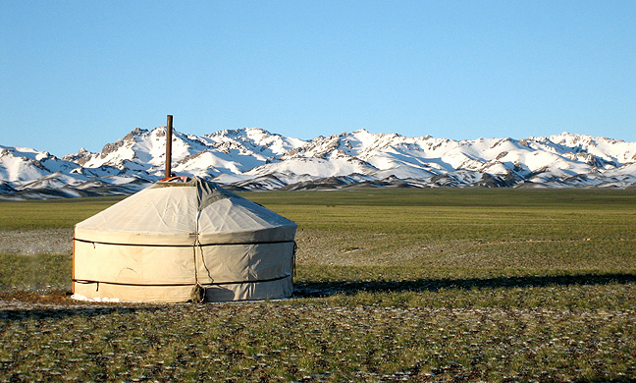
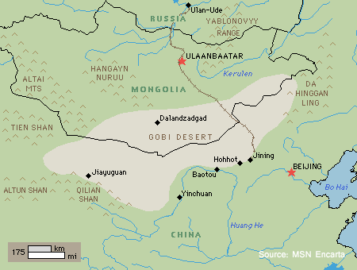
The Mongols and their Surroundings
Lived as clans, north of the Gobi Desert
Everyone was skilled horse riders and valued hunting, courage, and warfare
Lived in Yurts with basic supplies to survive the harsh conditions

Slide 3
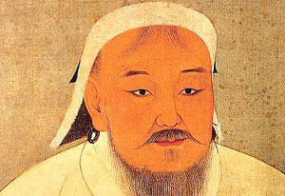
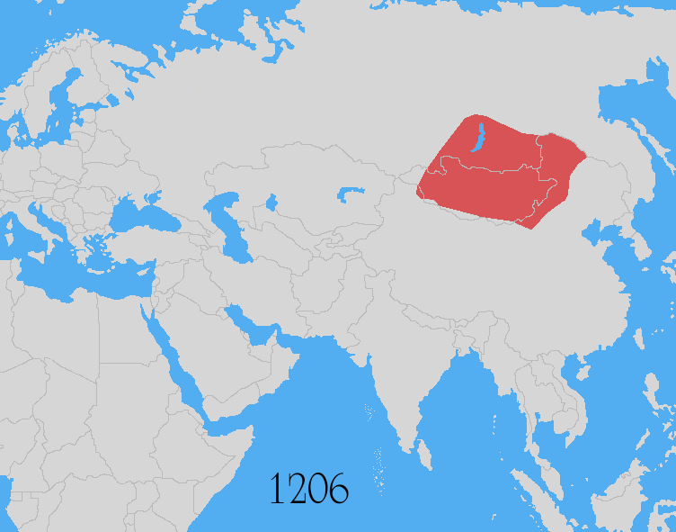
Genghis Khan
Original name is Temujin, born in 1162
Did whatever it took to succeed: killed his step-brother, promoted non-family members, and was all about personal loyalty
After he accumulated total power, he took the name Genghis Khan, aka ruler of all

Slide 4
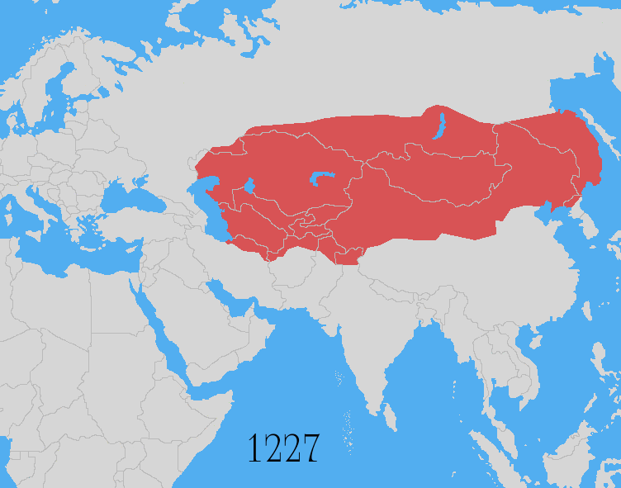
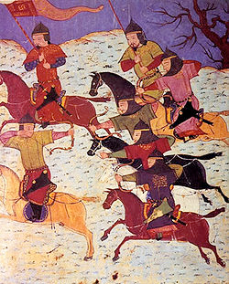
Genghis Khan’s wars
Anyone who resisted was brutally killed in retribution… aka killed the armies, then the civilian towns
By 1227, his empire reached from the North China Sea, to eastern Persia
Troops were highly deciplined, used the short bow from horseback, organized into groups of 10 with 1 in charge, and his troops were called tumens

Slide 5
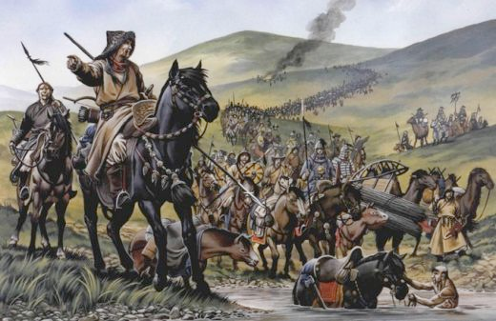
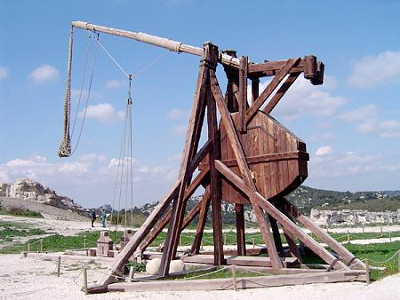
More on him at war
They mapped out terrain so they knew what it was before going into battle
Would always fake out his enemies, then flank them
When coming on an enemy town, would ask for their surrender, if refused he killed all of the aristocrats, and took the skilled workers for his empire
Incorporated weapons from conquered territories, like siege weapons from china

Slide 6
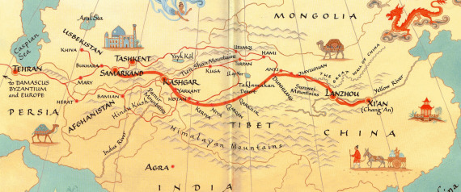
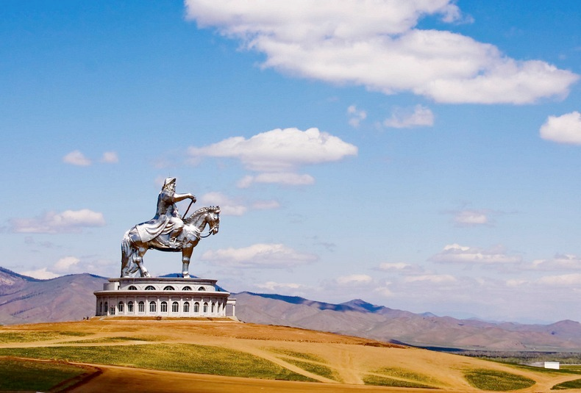
Khan at peace
Pax Mongolica between the 13th and 14th centuries
Built more bridges than any other ruler in history
Instituted a policy of religious tolerance
His soldiers protected the Silk Road

Slide 7
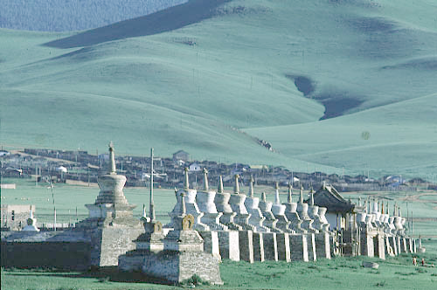
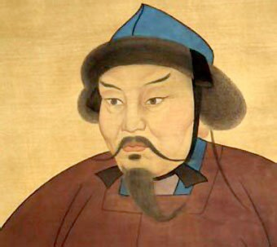
Genghis Khan’s Successor
He died while fighting the Tangut Empire
His favorite son Ogodei was elected, and while he wasn’t as good, he still expanded the empire
Brought a more efficient bureaucracy, also developed the capital Karakorum.

Slide 8
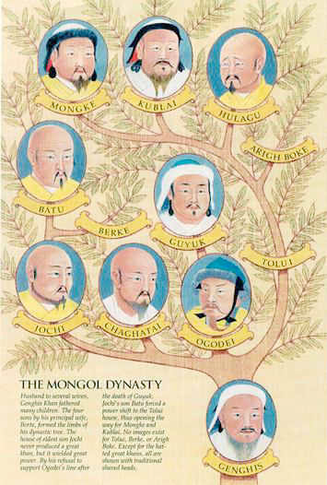
Batu and the Golden Horde
The first of Khan’s three grandsons, commanded an army of 100,000 soldiers into Russia, became known as the Golden Horde
Was pushing into Western Europe, then Ogodei passed away, so he returned for his funeral, and lost interest in expanding further westward
Mongols didn’t want to live in the forrests, so set up a tribute system, but eventually, Moscow led a revolt in 1380 at the Battle of Kulikovo, and defeated the Mongols
Forced Russia to develop a military, and sever ties with Western Europe

Slide 9
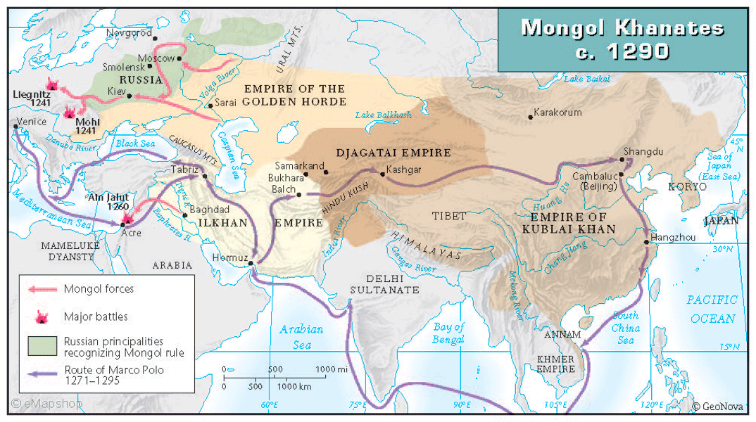
Hugely and the Islamic Heartlands
Attacked the Abbasid territories, destroyed Baghdad, killed the caliph and around 200,000 residents of the city
Defeated by an alliance between the Muslim Mamluks, and Christian Crusaders in Palestine
Il-khanate stretched from Byzantium to the Oxus river, many converted to Islam.
Before Islam = religious tolerance, after conversion = massacres of Jews and Christians

Slide 11
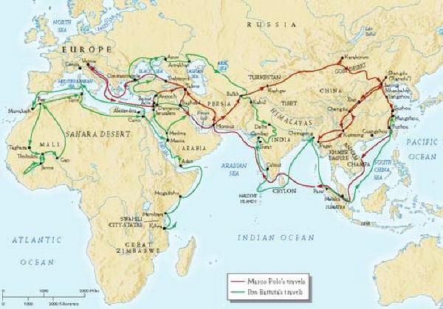
Cabal Khan and the Yuan Dynasty
Defeated the Song Dynast in 1271 after 11 years of war
He established that Yuan Dynasty, rebuilt the capital at Zhongdu, called it Dadu
Was much like his grandfather in how he governed
During this time, 17 year-old Marco Polo visited China, he returned to Italy in 1295 and wrote a book about his trip, but Europeans didn’t believe what he said about how great china was

Slide 12
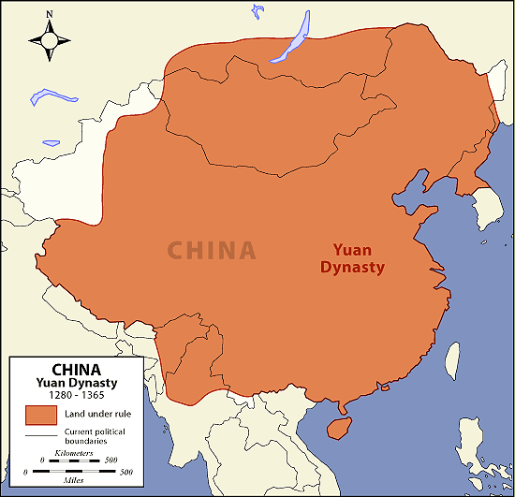
More on Kublai
Upset the Chinese eventually by using foreigners to run the government instead of Chinese
Mongols also hated the Confucius teachers
Eventually, a Buddhist monk from a poor peasant family, Zhu Yuanzhang, overthrew the Mongols and founded the Ming Dynasty
Why couldn’t they expand further??? (Geography)

Slide 13
Long-term impact of Mongol Invasions
They realized interregional Trade between: Asia, the Middle East, Africa, and Europe
Conquest helped transmit the fleas that carried the bubonic plague from Southern China to the rest of the world
Mongol women were more independent, wore pants, could remarry and initiate divorces
Fighting techniques led to the end of Western Europe’s knights in armor, speed was better
Ended the era of the called city.. love those Mongols’s siege tech and the cannon
Finally, changed from tunics and robes, to pants and jackets!!!!

Slide 14
Wait for it.. the mongols!
https://www.youtube.com/watch?v=szxPar0BcMo

