Slide 1
Tropical Africa and Asia
Chapter 14

Slide 2
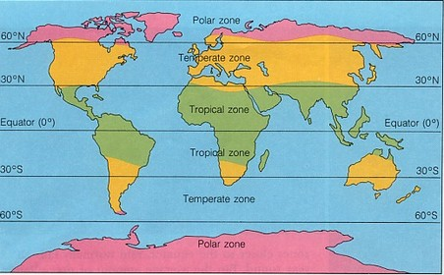
The Tropics
Boundaries
Tropic of Cancer
Equator
Tropic of Capricorn
Countries
Majority of Africa
Majority of India
SE Asia
Monsoon winds
Southern moving winds bring dry seasons

Slide 3
Tropical Foraging and Herding
Foraging
Herding
Pygmy hunters
Central Africa
Hunter/gatherer
Himalayan foragers
Central Asia
Areas too arid for agriculture
Largest population of pastoralists
NE Africa, Arabia
Tuareg
Western Sahara
Camels, sheep
Fulani
Southern Sahara
Cattle herders

Slide 4
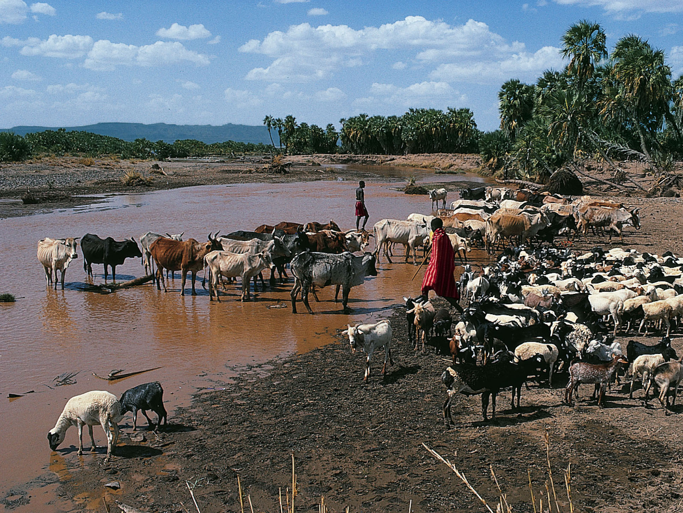
Notes:
East African Pastoralists.
Herding large and small livestock has long been a way of life in drier parts of the tropics.

Slide 5
Tropical Agriculture
Areas with adequate rainfall
South, Southeast Asia (more than Africa)
Areas with high agricultural production = high population density
1200 CE: SE Asian population =100 million people
4/5 live in India
Slightly smaller than China
3x African population
2x European population
Spread of farming
African/Asian crops
Yams, bananas

Slide 6
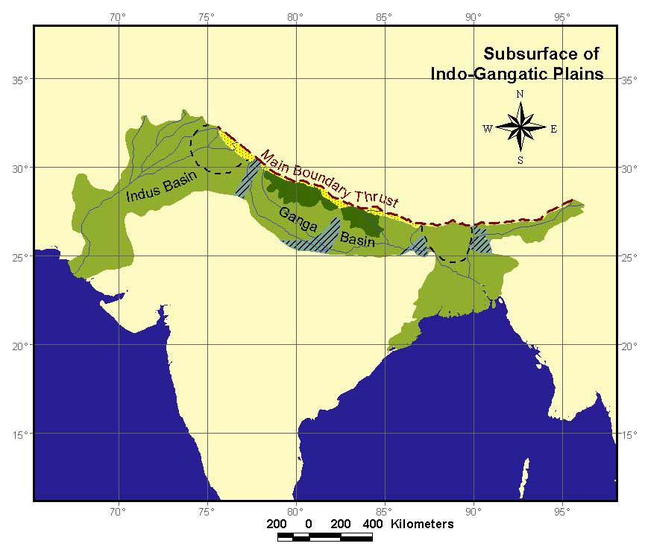
Agricultural Products
Ganges: Rice
Dry areas
Wheat
Sorghum
Millet
Peas
Beans
Slash and burn agriculture

Slide 7
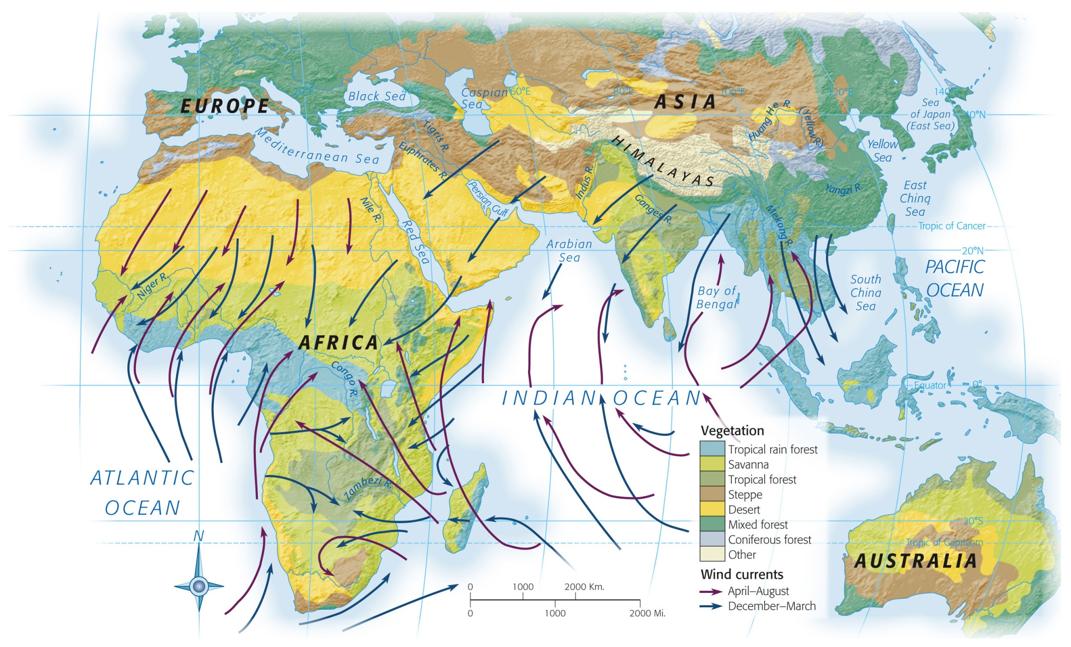
Notes:
Map 14.1: Africa and the Indian Ocean Basin: Physical Characteristics.
Seasonal wind patterns control rainfall in the tropics and produce the different tropical vegetation zones to which human societies have adapted over thousands of years. Wind patterns have also dominated sea travel in the Indian Ocean.

Slide 8
Water
Niger delta: flooding
Monsoon rain storage
Burma, Malaya, Java, Vietnam
Terrace farming
Controlled water system
Rice
Government sponsored irrigation systems
Delhi Sultanate (N. India)
System unsurpassed until 19th century
Sugar cane, cucumbers, melons
Ceylon
10th century: world’s largest concentration of canals/irrigation systems
Ruin by 1400 due to invaders—spread of malaria
May not be built back after damage

Slide 9
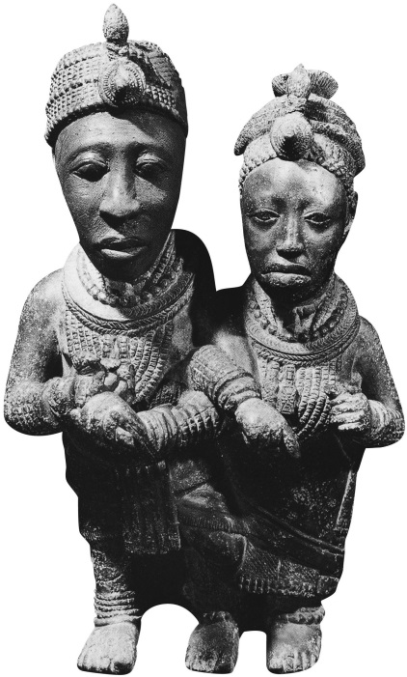
Other Resources
Copper
SE Africa
Copperbelt
Smelting viewed as “magic”
Used as currency (Sudan)
Wire, decoration
Copper, brass statues
Iron
Tools
Hoes, axes, knives, needles, nails
Used to clear land for fields, etc
Weapons
Spear, arrow
Indian swords
Gold
Ghana
Traded across Sahara and to Indian Ocean basin
Notes:
King and Queen of Ife.
This copper-alloy work shows the royal couple of the Yoruba kingdom of Ife, the oldest and most sacred of the Yoruba kingdoms of southwestern Nigeria. The casting dates to the period between 1100 and 1500, except for the reconstruction of the male’s face, the original of which shattered in 1957 when the road builder who found it accidentally struck it with his pick.

Slide 10
Islamic Empires

Slide 11
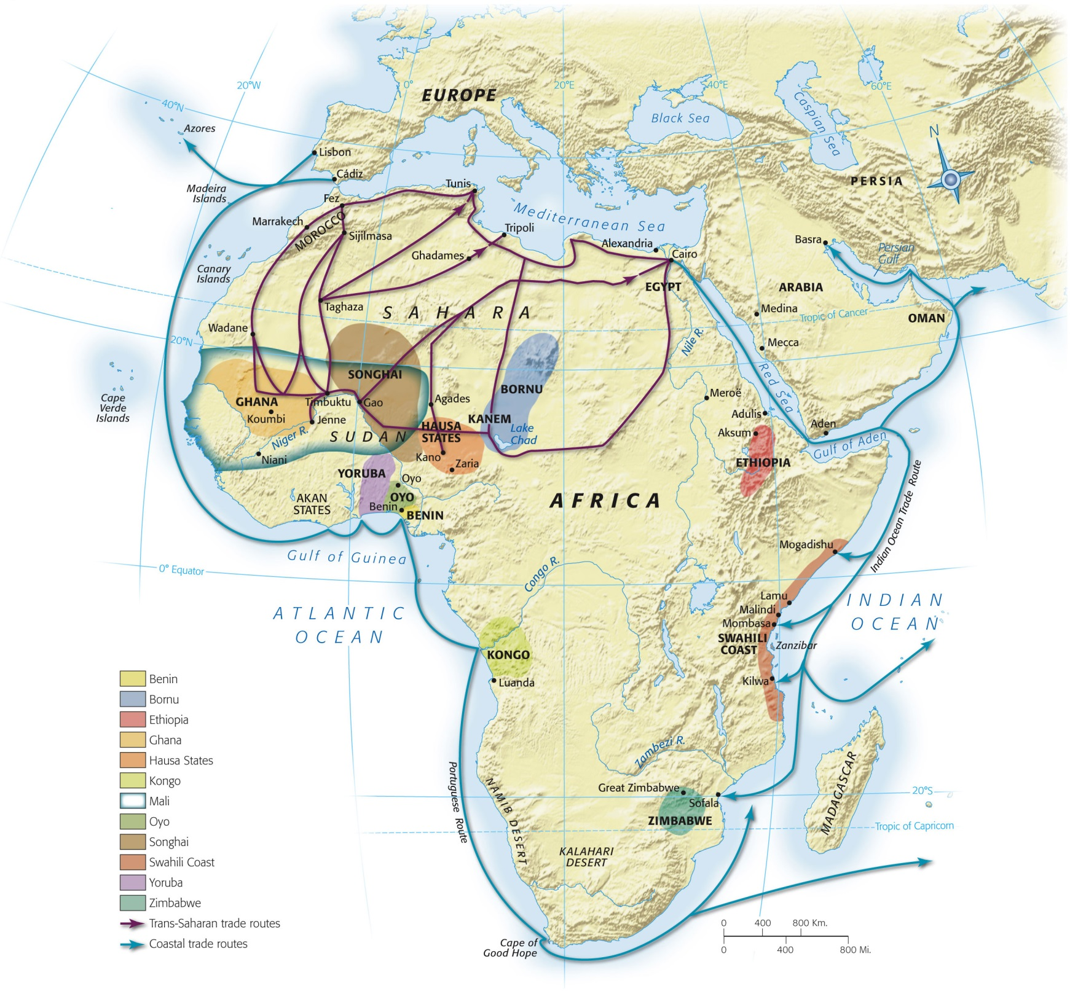
Map 14-2, p. 373
Notes:
Map 14.2: Africa, 1200–1500.
Many African states had beneficial links to the trade that crossed the Sahara and the Indian Ocean. Before 1500, sub-Saharan Africa’s external ties were primarily with the Islamic world.

Slide 12
Muslim Rule
Began rule in Africa in 7th century
Trade increased
Religion spread peacefully in majority of Africa
1030: Takrur = first sub-Saharan state to adopt Islam
Muslim Berbers
1076: invade and cause fall of Ghana
Destroy Nubia (Christian)
Only Ethiopia resists Islam

Slide 13
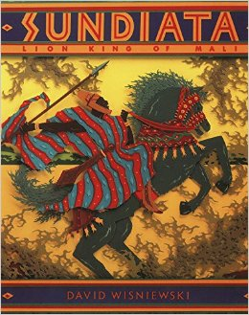
Malinke leader (Mali)
Defeated Takrur and King Sumanguru ca. 1200
Both Muslim
Clash of magicians
Smaller army than Takrur, better tactics, magic
Sumanguru wounded with magic arrow that robbed him of powers

Slide 14
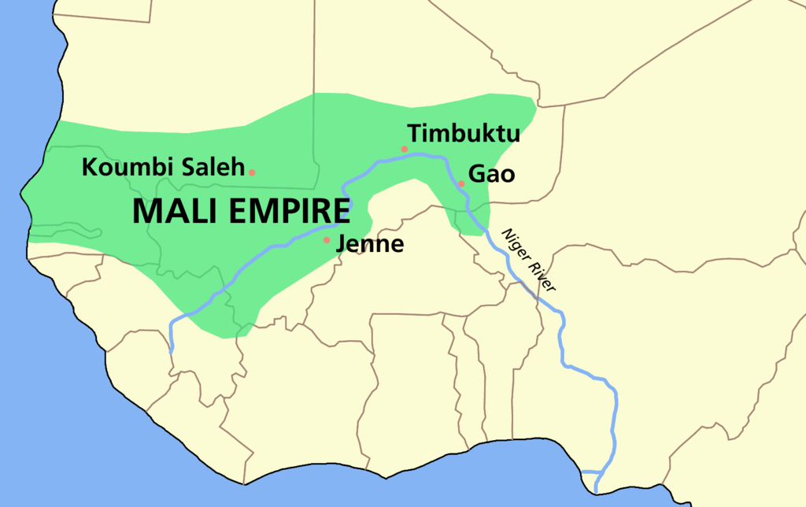
Mali
West Africa
Largest, richest African state between 1200-1500
Wealth depended on trans-Saharan trade and agriculture
Controlled larger area than Ghana
Upper Niger trade and gold fields

Slide 15
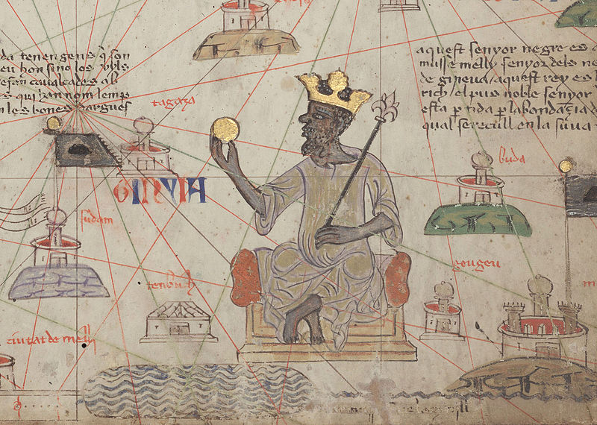
Mansa Musa
Ruled Mali from 1312-1337
1324: Pilgrimage to Mecca
Displayed personal wealth
Wife, 500 ladies in waiting, slaves
60,000 porters
Caravan of camels
Mosques, schools
Gifts
80 pkg of gold (122 oz each)
500 slaves w/ golden staffs
Value of gold diminished in Cairo
80x122=9760 oz
9760x1162.70=
$11,347,952.00
(in just gold “bars”)

Slide 16
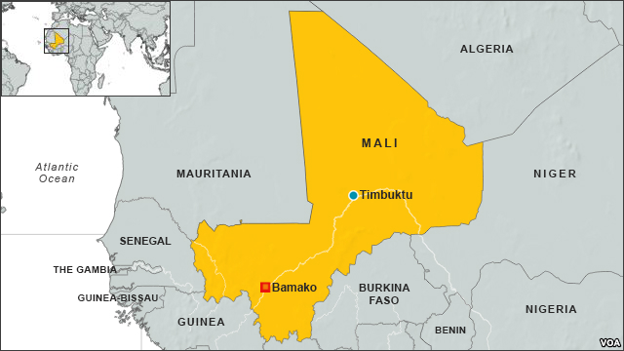
Mali’s Decline
Mansa Suleiman
1341-1360 (reign)
Ibn Battuta
“complete…safety”
Could not prevent rebellion
External threats
1433: Tuaregs retake Timbuktu
Upper Niger cities survived
Epicenter moves to Sudan
Manufacture/trade cities
Cotton textiles, leather
ISLAM

Slide 17
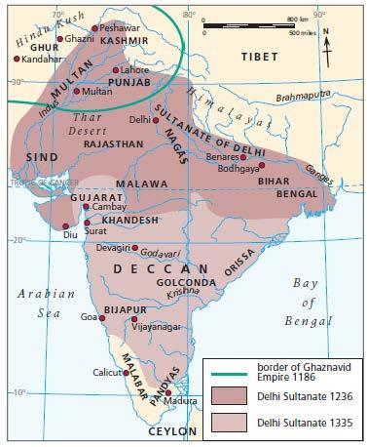
Delhi Sultanate (India)
12th Century
Turks capture Delhi in northern India
“Freed” from idols and idol-worship (Hindu)
Sultan Iltutmish
Conquest/establishment of large kingdom
Recognition of Delhi Sultanate as Muslim state
Declared his daughter, Raziya, heir
Proved to be good ruler
Dressed as a man
Assassinated

Slide 18
Expansion
Ala-ud-din Khalji
1296-1316
Frontier raids, high taxes
Network of spies
1298: Annexed Gujarat
Muhammad ibn Tughluq
1325-1351
Received Ibn Battuta
Expanded sultanate to largest size
Religious toleration of Hindus
Sultan Firuz Shah
1351-1388
Alienated Hindus
Good relations with Muslims

Slide 19
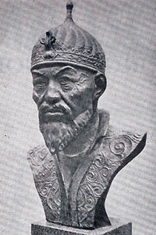
Fall and Legacy
Fall
By 1351-Southern India had established independent states from the Delhi Sultanate
1338: Bengal leaves Sultanate
1390: Gujarat gains independence
1398: Timur the Lame (Timurlane) captures Delhi
Legacy
Development of centralized political authority
Bureaucracy
Food production, trade, common currency

Slide 20
Indian Ocean Trade
Indian Ocean divided into 2 sections
Middle East to India
India to SE Asia
Ships could not make a voyage from ME to SE Asia
Luxury goods
Precious metals, gems
Spices, textiles
Bulk shipments
Cotton, pepper, grain, horses

Slide 21
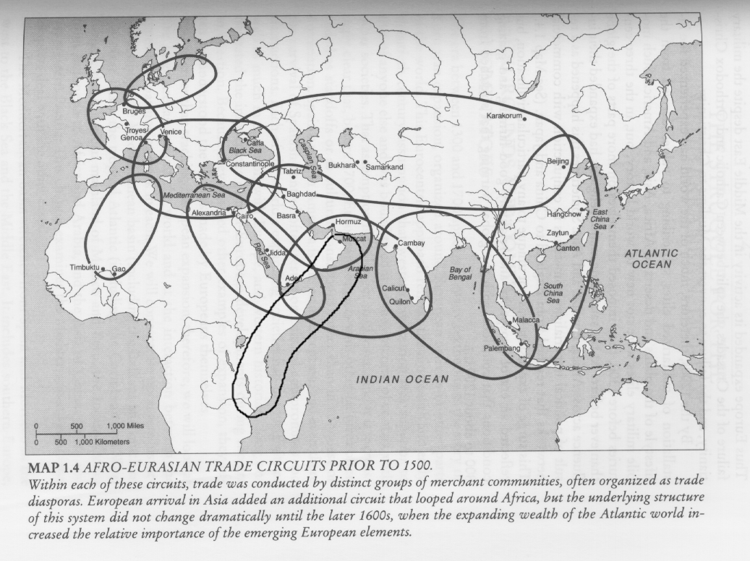

Slide 22
Ship Technology
DHOWS
JUNKS
Malabar Coast (SW India)
Cargo/passenger ships
Arabian Sea
Sewn planks
Capacity of 400 tons by 1500
Small dhows: in sight of land
Large dhows: Red Sea to SE Asia in 2-4 months
Majority transferred to junks in India
Largest, most technologically advanced ship
Dominated Indian Ocean / South China Sea
Nailed planks
Up to 12 sails, 1000 crew

Slide 23
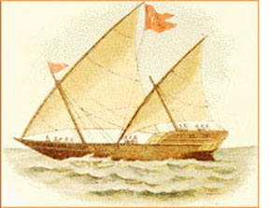
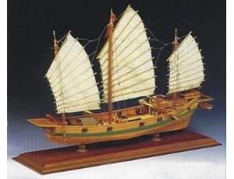
Comparison
Dhow
Junk

Slide 24
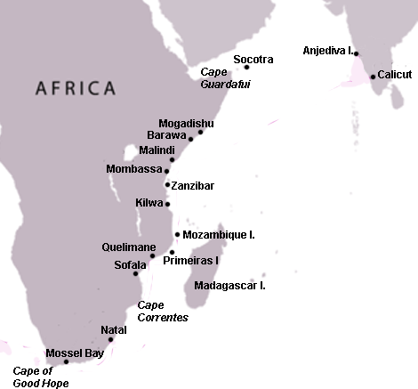
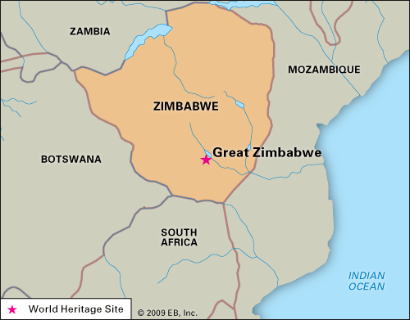
Africa
1250-1500
30-40 city states develop
Masonry replaces mud/thatch buildings
Imported glass beads, Chinese porcelain
Swahili Coast
Gold from inland E Africa
Kilwa
Surpasses Swahili Coast as the main commercial center in Africa by 1330s
Late 15th cent: export 1 ton of gold annually
Great Zimbabwe
Gold exports, copper, salt
Over grazing of grassland, deforestation

Slide 25
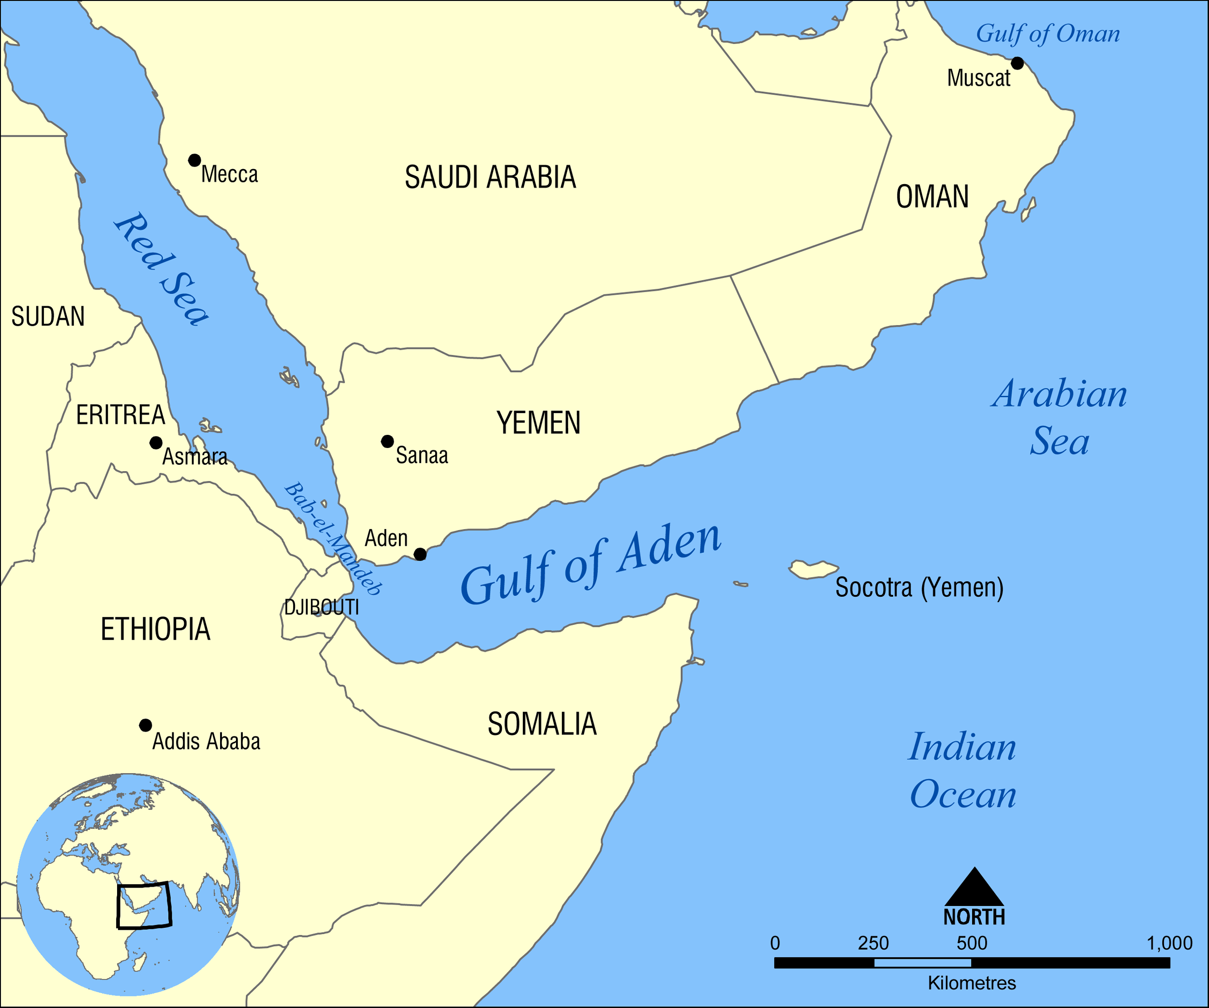
Arabia
Aden
SW Arabia
Monsoon winds
Drinking water
Grain
Horses, grain, opium, dyes
India: cotton, beads
SE Asia: spices
Ethiopia: horses, slaves, gold
Red Sea: pearls
Cairo: manufactured luxuries

Slide 26
India
Gujarat
Revitalized after Mongols sack Baghdad
Delhi ruling class
Cotton textiles and indigo to Europe
Gold, silver
Cotton, beads, food to Swahili Coast
Manufactured goods (leatherwork)
Cambay
Compared to Flanders (Italy)
Quality cotton, linen, silk
Carpets, gems, gold, ivory, pearls
Hindu merchant caste = $$
Calicut
Local cotton, grain, spices

Slide 27
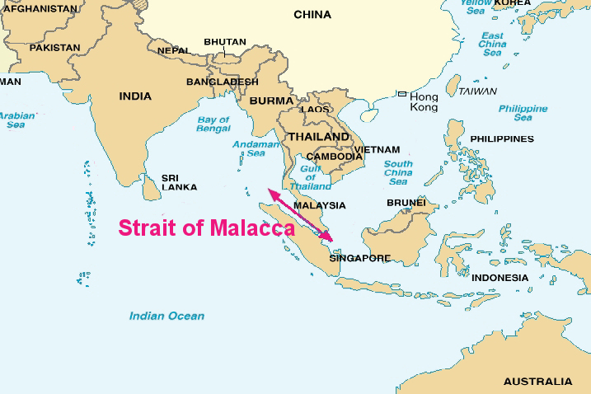
SE Asia
Strait of Malacca
Important sea port
Alliance with China (pirates)
Trade emporium city
Burma: rubies
Malaya: tin
Sumatra: gold
Spice Islands: cloves, nutmeg

Slide 28
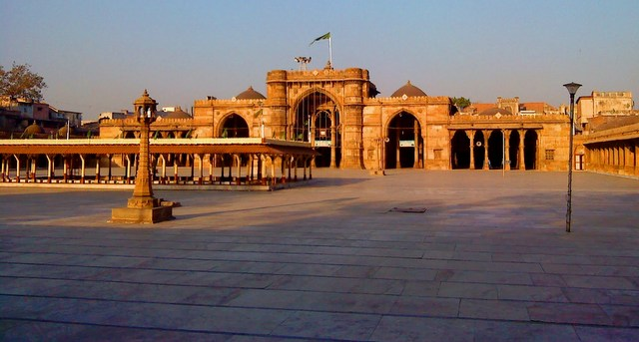
Architecture
Lavish mansions, palaces, places of worship
African Muslims: Middle Eastern mosque in local materials
Sun baked clay, coral stone
Gujarat: Muslim architecture inspired by Hindu temples
Cambay: Sacked Hindu temples become mosques

Slide 29
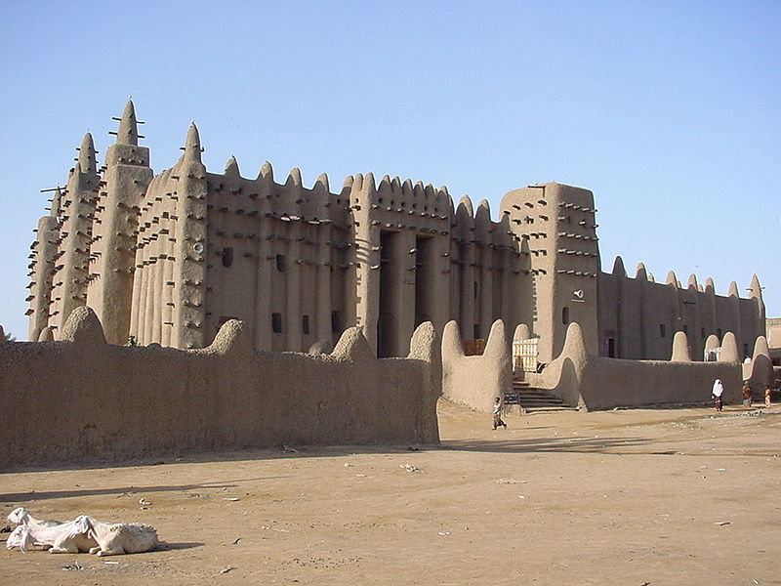
Great Mosque of Djenné (Mali)

Slide 30
Literacy and Religion
Mosques = learning centers
Boys memorize Quran
Arabic words (Sahara, Sudan, Swahili, monsoon)
Islamic superiority
Moral code
4 wives
Indian Buddhism eliminated
Monks killed, manuscripts burned
Hindu slaves

Slide 31
Women and Slaves
Hindu women
Improved status
Sati was optional
Early arranged marriages
Ibn Battuta
Appalled at “Freedom of Women”
Not veiled, talk w/ men
Mali, Bornu
Slaves from Sahara to N. Africa
Eunuchs: guarded harems
Ethiopia: slaves sent to Aden
1200-1500
Saharan/Red Sea
2.5 million slaves
Reached India/China

Slide 32
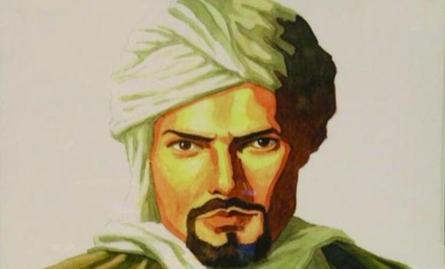
Ibn Battuta (1304-1369)
Abu Abdullah Muhammad Ibn Abdullah Al Lawati Al Tanji Ibn Battuta
Born in Tangier, Morocco (Berber family)
1325: Pilgrimage to Mecca
Did not return for 24 years
75,000 miles; 29 years
Trained qadi (judge)
Al-Rihla (“The Travels)
Recorded observations, notes, etc
Transcribed by Ibn Juzay
“Travel Blog”

Slide 33
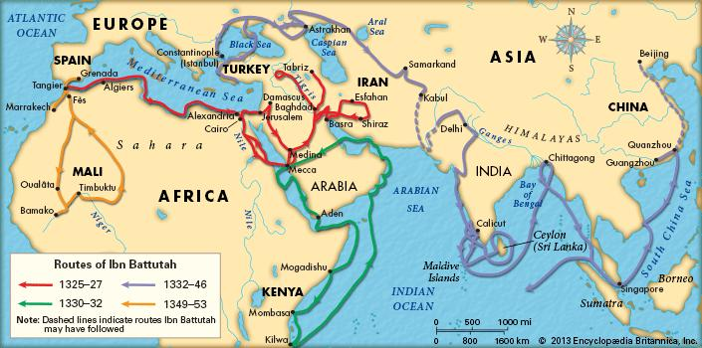
Travels
N. Africa
Egypt
Swahili Coast
Mecca
Palestine
Syria
Anatolia
Persia
Afghanistan
India
Sri Lanka
China

