Slide 1
Images to Know
Chapters 1-4
The Earth and Its Peoples
Bulliet

Slide 2
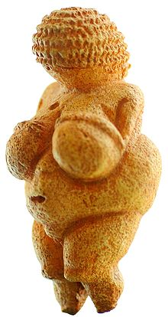
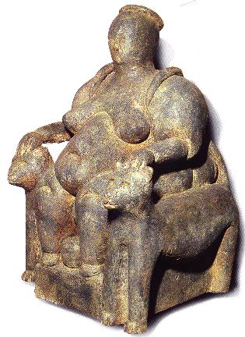
Fertility Goddesses
Venus of Willendorf
Mother Goddess: Catal Huyuk

Slide 3
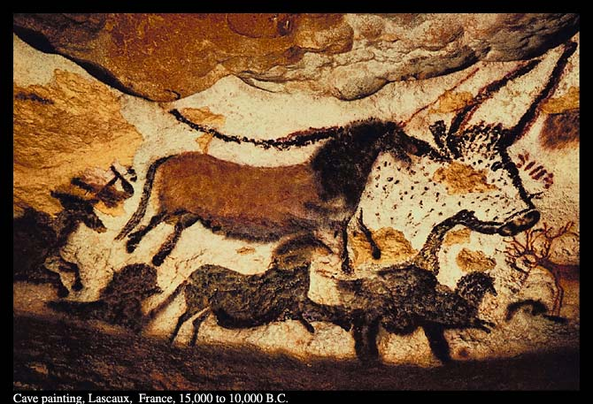
Cave Paintings from Lascaux, France

Slide 4
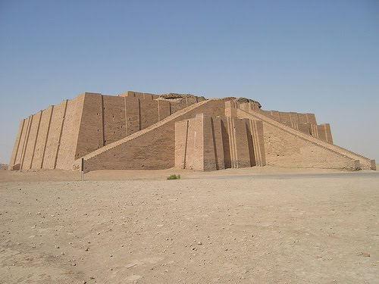
Ziggurat of Ur

Slide 5
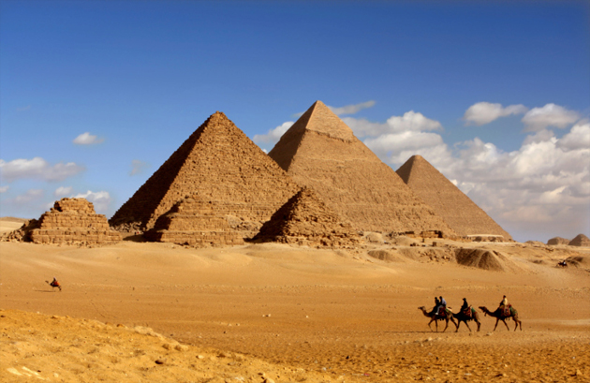
Pyramids at Giza

Slide 6
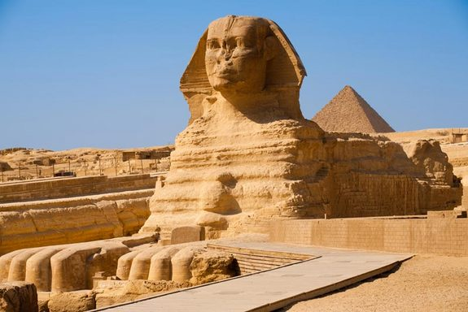
Sphinx

Slide 7
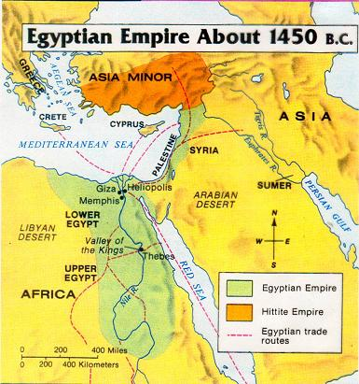
Memphis: Capitol of the Old Kingdom
Thebes: Capitol of the Middle and New Kingdoms

