Slide 1
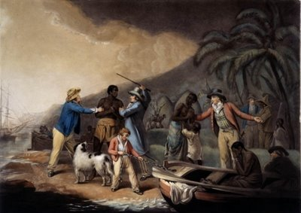
Chapter 20: Africa and the Africans in the Age of the Atlantic Slave Trade

Slide 2
Pre-Existing Slave Trade
Trans-Saharan trade routes (Red Sea and East African) had been trading slaves for centuries throughout the Middle East and Northern Africa
Mostly women: traded as concubines for harems; domestic servants
Some men: soldiers, field workers (salt production and gold mines), caravan laborers
Europeans tapped into existing routes and supplies of slaves.
Used this to justify their own enslavement of Africans in New World
Mid 1400s: Europeans begin to utilize slaves in Europe as household servants
Other forms of servitude used by Europeans:
Indentured servitude: Required to work for a master for “X” years in exchange for journey to European colony
Impressment: Taking men, usually other sailors, into a navy by force

Slide 3
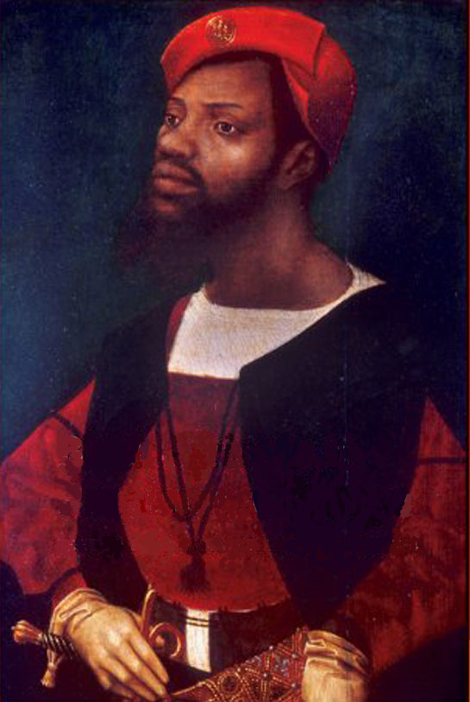
Portuguese Exploration
Portugal needed slaves for cash crop islands
Success with slaves prompts further participation by Portugal in slave trade
1441: First slaves brought to Portugal from Africa
Established outposts (factories) at El Mina, Luanda, Mozambique Island, Kilwa, Mombasa.
Also searching for gold, spices, pepper
Had to work with consent of local African rulers
Impressed with organization of African kingdoms (Kongo, Benin, Mali, Songhay)
Missionary efforts undertaken to convert African kingdoms
Nzinga Mvemba of Kongo made the region Christian with Portuguese support

Slide 4
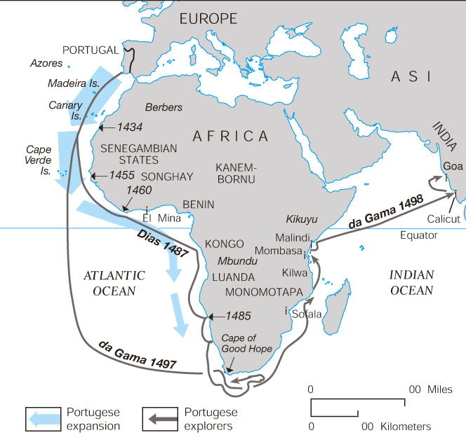
Portuguese Expansion and Major African Kingdoms

Slide 5
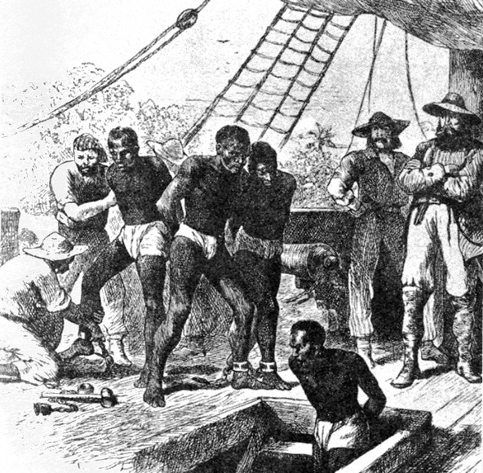
Competition in the Slave Trade
Slave trade became increasingly important as plantations (especially sugar and tobacco) demanded constant labor.
By 1600: the slave trade predominated over all other kinds of commerce on African coast.
Portugal controlled most of African coastal slave trade until 1637 when the Dutch seized El Mina in 1637
Portuguese no longer monopolize slave trade
By 17th c., Dutch, English and French competed with the Portuguese.
Trans-Saharan slave routes continued during this period.

Slide 6
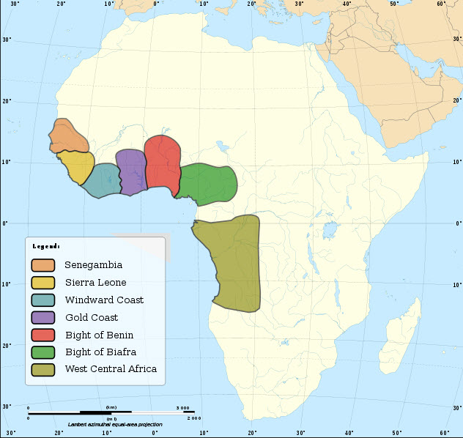
Obtaining Slaves
Slaves were usually prisoners of war or captives from African slave raids against neighboring African kingdoms or villages.
African rulers generally did not enslave their own people, but enslaved neighboring peoples.
Once Europeans traded for Africans, slaves were forced to march to trading towns, and often separated from families
25-33% died making this journey
Initially, slaves were taken from the Senegambian region, but later were taken primarily from west central Africa.
Simultaneously, over 3 million slaves were taken by Muslim traders for Trans-Saharan trade.

Slide 7
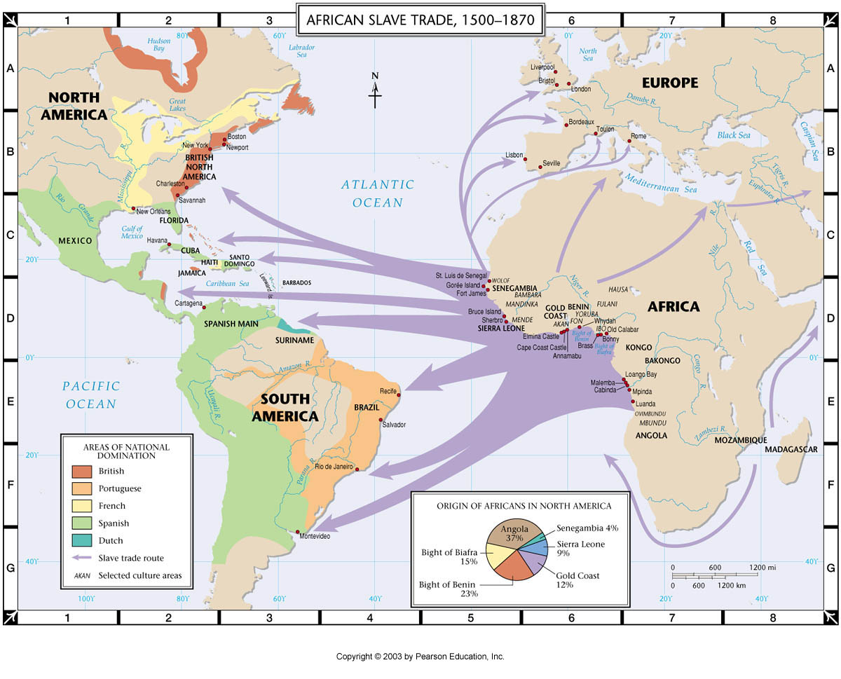
African Diaspora
Dispersion of Africans across globe; accomplished primarily by slave trade
African cultures adapt to the location in which they were placed
Retain unique African elements

Slide 8
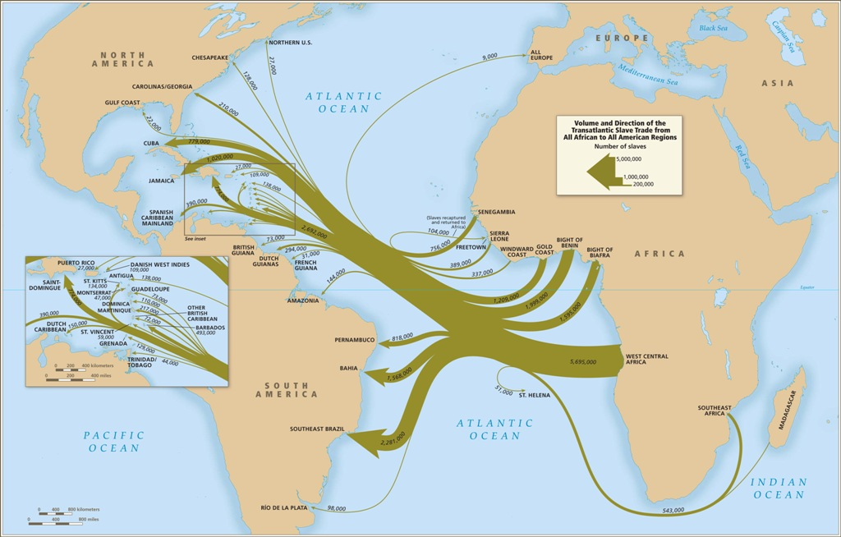

Slide 9
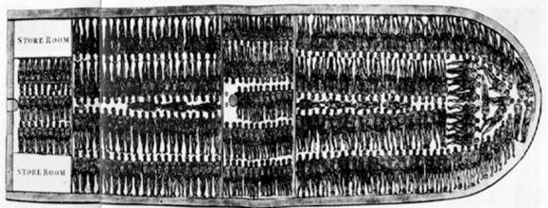
Journey Across the Atlantic
1450-1850: 12 million Africans shipped across the Atlantic
Highest volume traded in 18th century
Mortality rate on slave ships around 15-20%.
Mortality was high and fertility was low
Only way to keep large numbers of slaves in the Americas was to import more and more.

Slide 10
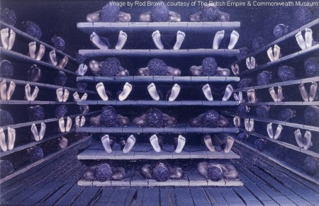
Journey Across the Atlantic, cont.
Cargo sizes varied; sometimes as high as 800 slaves in one ship
Middle Passage (slave voyage to America) was traumatic
Slaves were taken, branded by hot irons, shackled, abused throughout journey
Slave ships were dirty, unsanitary; many suffered from poor hygiene, dysentery, disease
Extreme anxiety, illness, suicide, resistance
When supplies ran low, the weakest slaves were thrown overboard

Slide 11
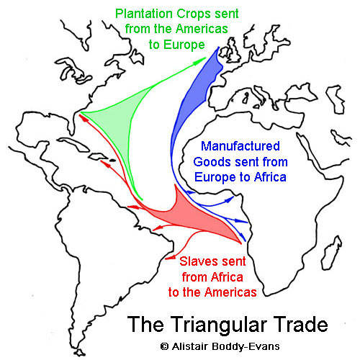
Profitability of Trade
Triangular Trade: made emerging capitalism central to Atlantic world
European manufactured goods (esp. guns) traded to Africans for slaves
Slaves transported from Africa to Americas (Middle Passage)
Slaves produce sugar, tobacco, molasses, rum; goods are traded to Europe
Royal African Company
English wanted their own source of slaves for growing plantations in Caribbean colonies
Establish trade forts in Africa to obtain slaves

Slide 12
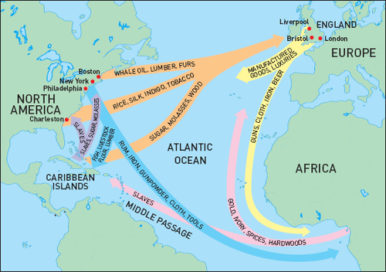

Slide 13
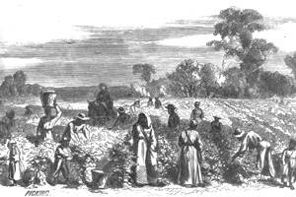
Plantations
Plantations became the focus of African slave life
Atlantic slaves were mostly men and used for plantation labor.
Sugar plantations in Brazil and Caribbean
Cotton and tobacco fields in British North America
Slaves performed many occupations: shop helpers, street vendors, household servants

Slide 14
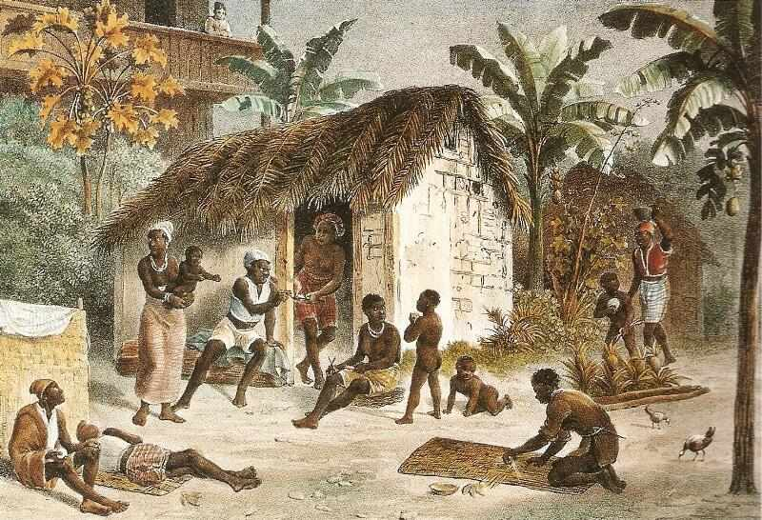
American Slave Societies
Terminology
Saltwater slaves (African-born)
Creole slaves (American-born descendants of African slaves)
Some were mulattos as result of sexual exploitation of slave women
Hierarchy of slaves created by slave-owners
Creoles and mulattos given more opportunities to acquire skilled jobs, such as house-hold servants
Family formation was difficult for slaves as families may be separated at any time
Male to female ratio sometimes 3:1

Slide 15
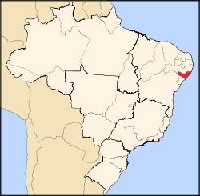
Religion and Rebellions
African Religion in the Americas
Conversion to Christianity by Europeans
African religions continued despite attempts by slave owners to suppress them
Often Christianity and African religions (including Islam) were fused
Some African nobles and religious leaders still exercised authority within African community
Rebellions
Palmares, 1605-1694: runaway slave kingdom in Brazil that resisted Portuguese and Dutch attempts to destroy it for 100 years
Suriname: plantation colony where large numbers of slaves ran off in 18th c. and waged war against captors

Slide 16
Effects of Slave Trade on Africa
Endless wars between African kingdoms and tribes promoted the importance of weaponry → sale of captive Africans was a way to obtain European gunnery
Most powerful African communities quickly became those who were willing to trade slaves with Europeans
Obtained in exchange: firearms, iron, horses, cloth, tobacco
Result: Gun and Slave Cycle
Increase firepower allowed African states to expand over neighbors, producing more slaves, which they traded for European guns
Result: unending warfare and disruption of societies through slave trade
Europeans intensified African enslavement that had already existed.

Slide 17
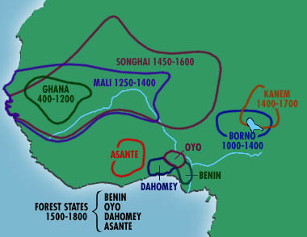
Asante and Dahomey
Two major empires rose to prominence in the Slave Trade period.
Asante: dominant state on Gold Coast
Osei Tutu: supreme civil and religious leader
Controlled gold-producing zones (1/3 of total trade) and traded slaves (2/3 of total trade)
Dominant slave trading state of Gold Coast until 1820s
Dahomey
Gain access to firearms in 1720s: creates autocratic and brutal political regime based on obtainment of slaves to trade to Europeans
Over 1.8 million slaves exported

Slide 18
East Africa
Swahili trading cities continued commerce in Indian Ocean, adjusting to military presence of Portuguese and Ottoman Turks
Plantation colonies quickly established along eastern coast of Africa and on Indian Ocean islands
Trade brought ivory, gold, slaves for harems and households of Arabia
Process of Islamization continues across Western Sudan
In some societies, Islam is still confined to upper classes
Other communities see Islam accepted at all levels

Slide 19
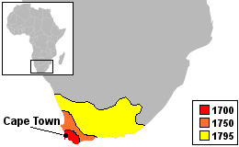
White Settlers and Africans in Southern Africa
16th c.: Bantu-speaking peoples occupied eastern regions of southern Africa.
Agriculture, herding, work with iron and copper
1652: Cape of Good Hope established as a Dutch colony for ships sailing to Asia
Initially dependent on slave labor brought from Asia but quickly turn towards African labor
Competition and warfare with indigenous Africans
By 1800: 17,000 settlers, 26,000 slaves

Slide 20
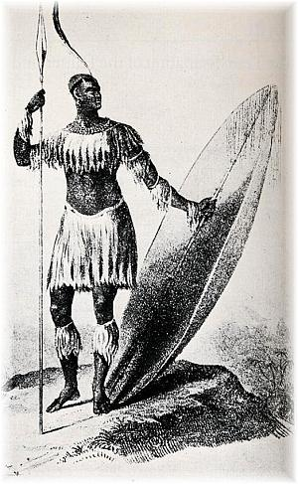
The Zulu Kingdom
1795: Great Britain seized Cape Colony from Dutch
Zulu Kingdom
Shaka Zulu (rules 1816-1828): Nguni leader of Zulu Kingdom who began African unification process in 1818
Militaristic kingdom; absorbed neighbors to build resistance against British
Mfecane (1815-1840): period of chaos amongst indigenous African communities in southern Africa; multiple civil wars and chaos between tribes
Anglo-Zulu Wars of 1879: Battle between British Empire and Zulu Kingdom
Despite some Zulu wins (Isandlwana), the war resulted in a British victory and the end of the Zulu Kingdom’s independence

Slide 21
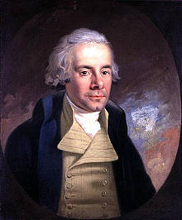
The Abolition of Slavery
Economic, political and religious changes are occurring in Europe and the colonies that prompt changes in attitudes towards slavery.
Opponents of slavery and brutality of trade appeared into the mid-18th century.
Response to Enlightenment thinkers
Slavery seen as backward, immoral, inhumane, cruel
1807: British slave trade was abolished
Abolitionists: John Wesley and William Wilberforce
1865: U.S. abolishes slavery with 13th Amendment
1888: Brazilian slave trade was abolished

