Slide 1
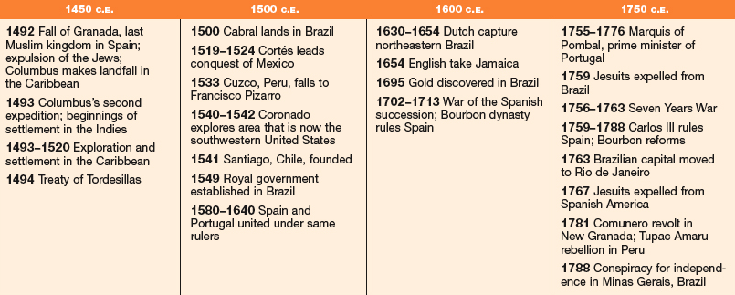
AP World History Chapter 17
Early Latin America

Slide 2
First Colonies in America
France built a fort in Florida so Spain sent 11 ships and 2000 men to found a colony and destroy the French fort. (St. Augustine)
The Spanish called the French heretics and killed its inhabitants hanging the bodies on trees.

Slide 3
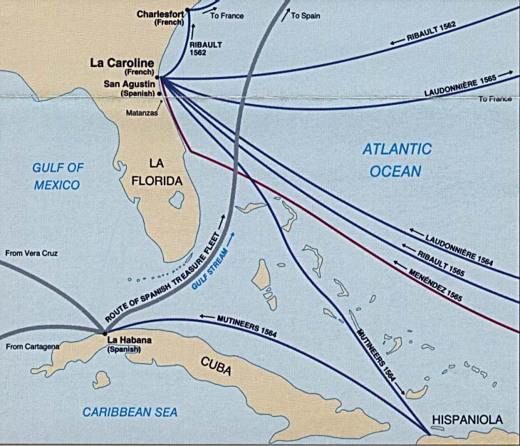

Slide 4
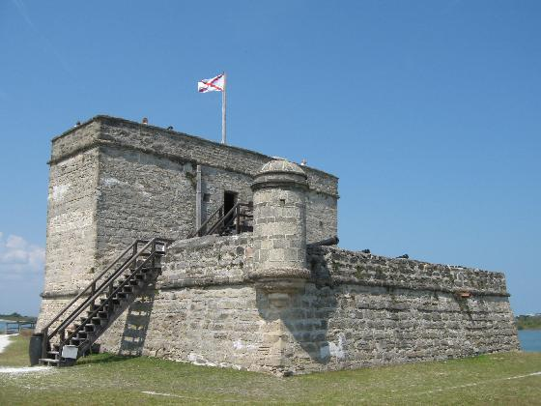

Slide 5
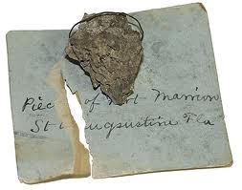
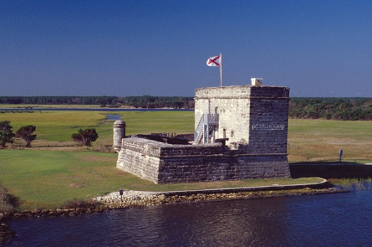
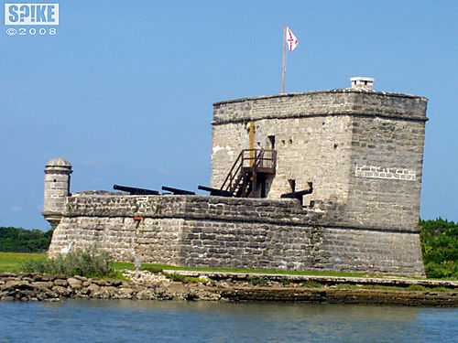
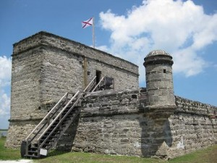

Slide 6
Spanish Explorers
Juan Ponce de Leon:
Looked for the “fountain of youth.
Named Florida in 1513.
Vasco Nunez de Balboa:
Led a group across the Isthmus of Panama.
First European to reach the Pacific Ocean.
Ferdinand Magellan:
His ships became the first to sail around the world it took three years.
Sailed through the channel between Antarctica and South America now known as the Straight Magellan.

Slide 7
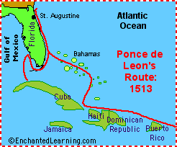
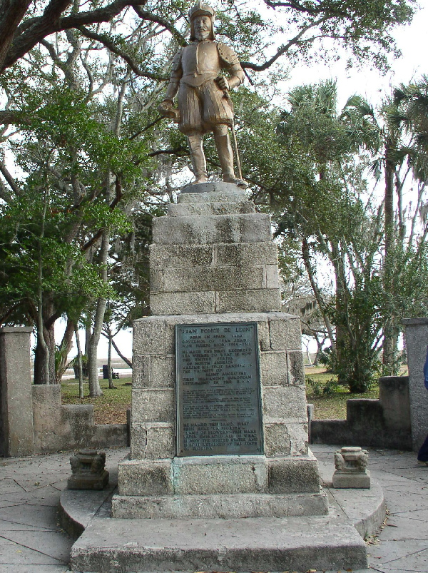

Slide 8
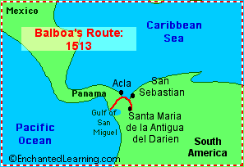
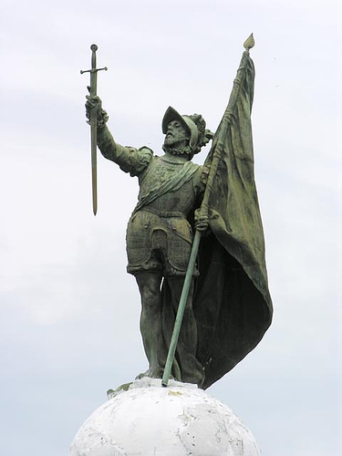
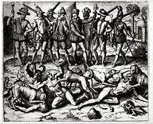
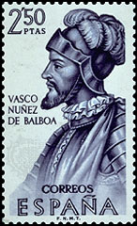
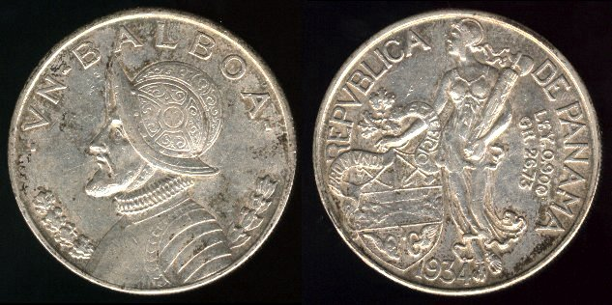

Slide 9
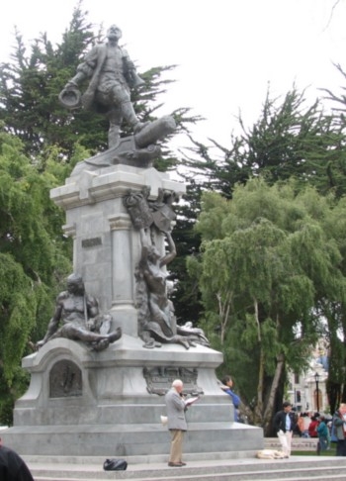
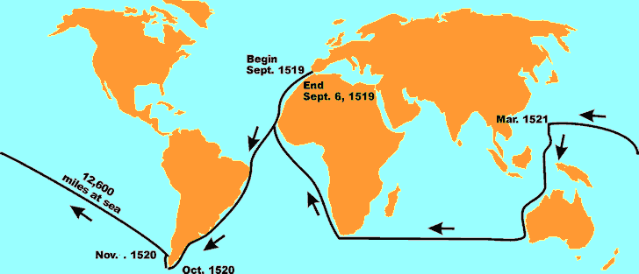

Slide 10
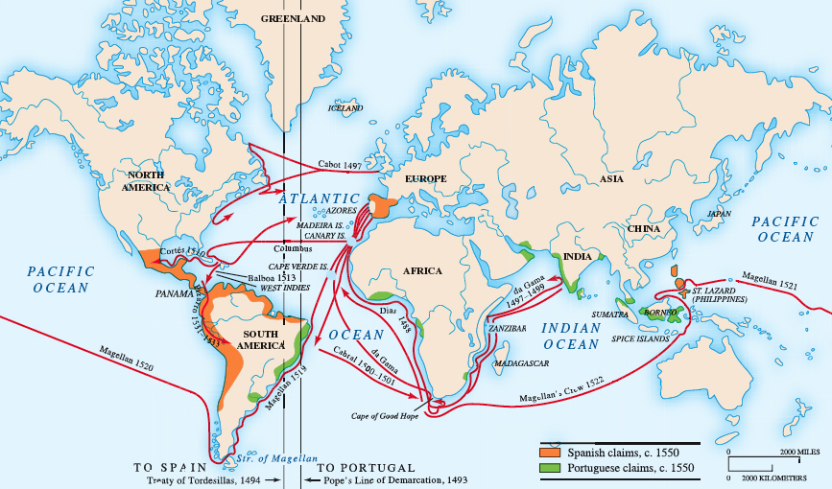

Slide 11
The Spanish Pattern of Conquest
The Spanish had been fighting to repel the Muslim invasion of Spain for 700 years.
They re-conquered all of Spain in 1492.
“God, Gold, and Glory.”

Slide 12
Conquistadors
Hernan Cortes, hungered for wealth and gold.
In 1519, Cortes was sent by the Spanish governor of Cuba to conquer the Aztec Mexico.
Cortes, landed 600 soldiers and quickly learned that most of the people governed by the Aztecs did not like them.
By 1521 Cortez had destroyed the Aztec Empire.
Francisco Pizarro led the conquest of the Inca.

Slide 13
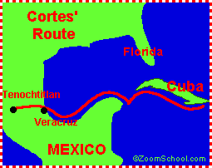

Slide 14
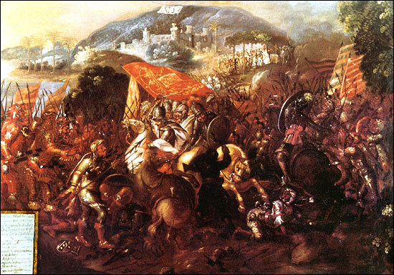

Slide 15
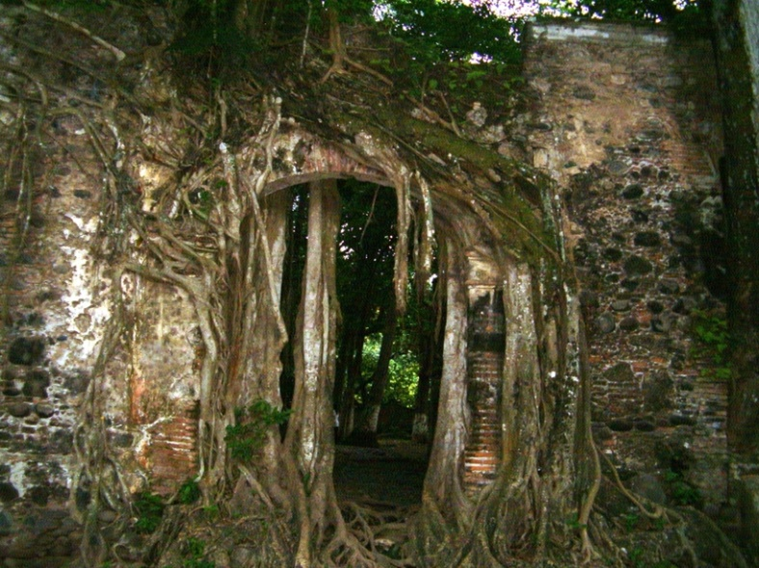
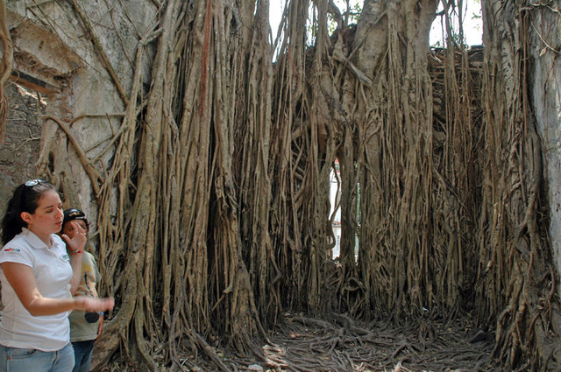

Slide 16
Spanish Settlement
Spanish settlement was geared towards exploitation of the natives on large farms known as encomiendas.
The Spanish mined for silver and gold.
The Spanish had children with natives who became known as mestizos or “mixed.”

Slide 17
Pushing North
Alvar Nunez Cabezza de Vaca was ship wrecked in 1528 along the Gulf Coast near present day Galveston, Texas.
Wandered for eight years before being rescued.
They told stories they heard about Seven Cities of Cibola, rumored to be filled with gold somewhere to the north.

Slide 18
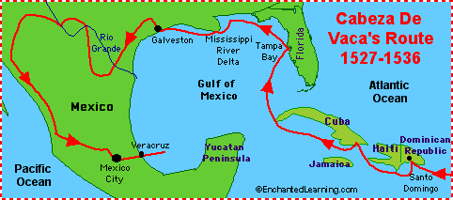

Slide 19
The Seven Golden Cities
Francisco Vasquez de Coronado:
He led a group of Conquistadors North through Texas up to Kansas but never found the city of Quivira. City of Gold.
Hernan de Soto:
Led 600 soldiers in search of another city of gold.
Traveled through Florida, Alabama, Tennessee, Mississippi, Arkansas, and Oklahoma. Died in Louisiana of feaver. No city.

Slide 20
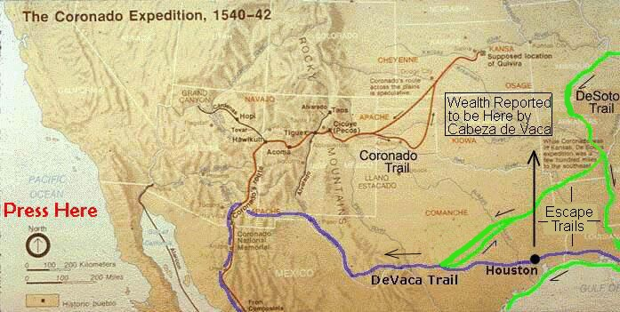

Slide 21
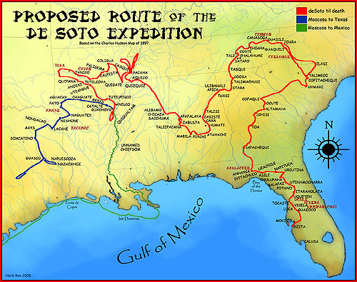

Slide 22
Forts for Defense
The Southeast Coast:
Built to protect the shipping lanes along the Gulf Stream.
The Southwest:
Protect future mining interests in New Mexico.
The West Coast:
They wanted to keep other European powers from controlling trade along the Pacific Coast.

Slide 23
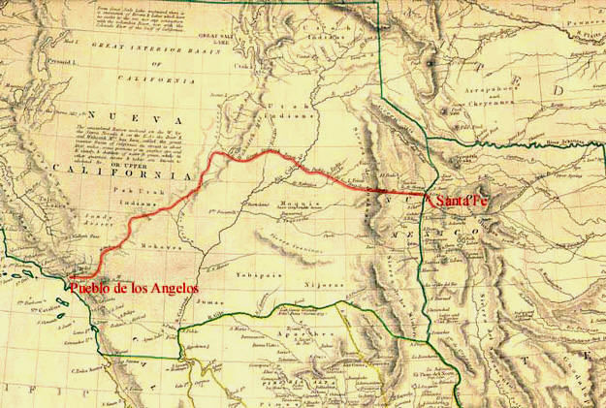

Slide 24
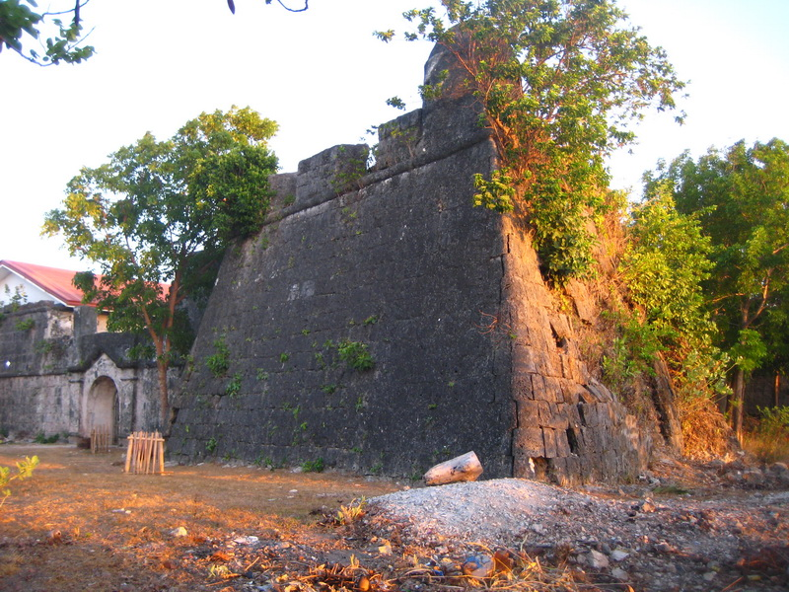

Slide 25
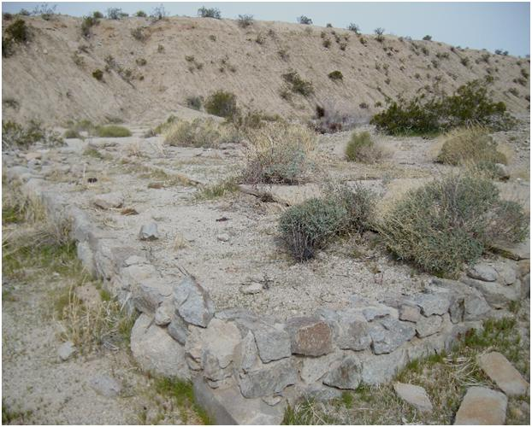
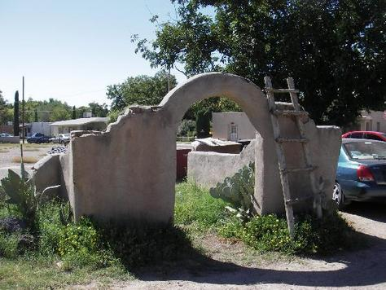

Slide 26
Resistance to the Spanish
Native Americans fighting against the Spanish was generally disorganized.
However, the Pueblo united in what is called the Pueblo Revolt of 1680.
They drove the Spanish out of Santa Fe, destroying all signs of Christianity. They killed the priests, colonists, and soldiers.
It was the only successful Native American uprising against Europeans.

Slide 27
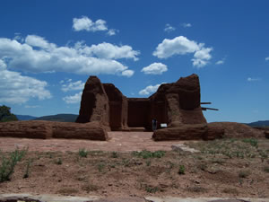
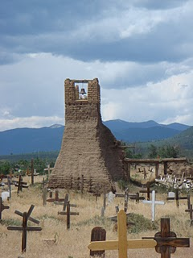
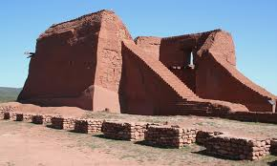

Slide 28
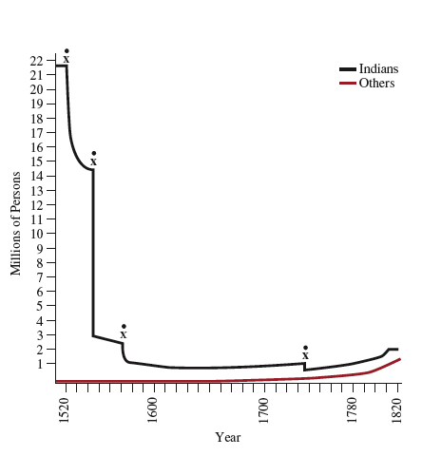

Slide 29
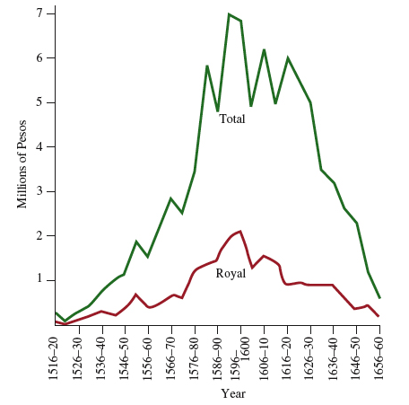
Colonial Economies and Governments
Industry and Commerce Sheep raising
Textile sweatshops
Silver trade preeminent
Only for Spaniards
Convoys cross Atlantic
Protected by galleons
Board of Trade
Oversees commerce
Consulado, merchant guild

