Slide 1
“A permanent division of labor inevitably creates occupational and class inequality and conflict. “
Robert Shea

Slide 2
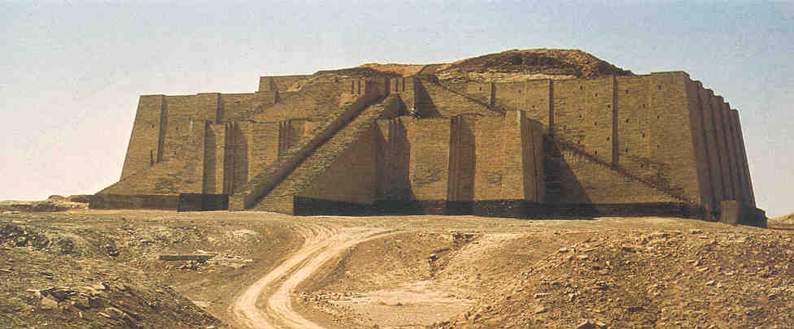
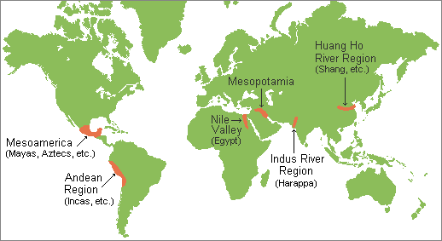
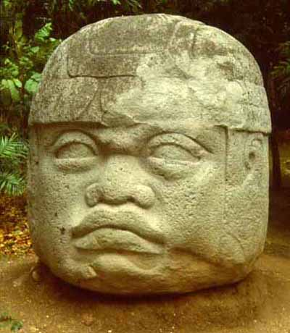
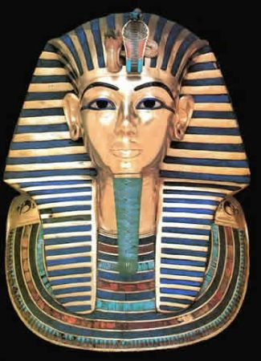
Cities, Inequalities, and New Social Realities
The First Civilizations
Developed around 3500 BCE - 3000 BCE

Slide 3
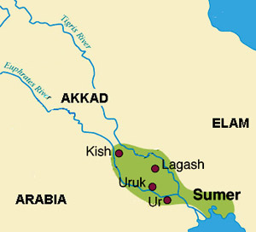
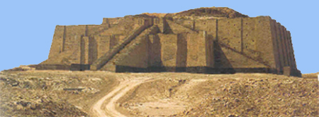
Cradle of Middle Eastern Civilizations – Mesopotamia
Competing city-states of Sumer
Surplus, Specialization, Cities, Writing
World’s earliest written language (Cuneiform)
Class hierarchy
Uruk, largest city, with population of around 50,000
by the third millennium BCE
Ziggurat, temple, in center of city

Slide 4
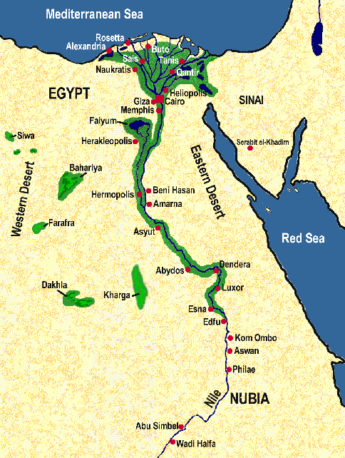
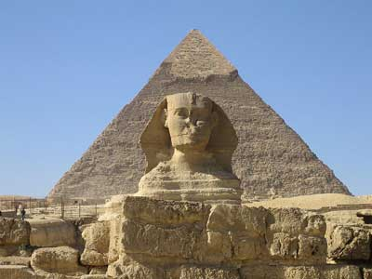
Nile River Valley in northeastern Africa
Unified state
Cities less prominent than in Sumer
Surplus, specialization, class hierarchy, writing
Pharaoh – divine ruler

Slide 5
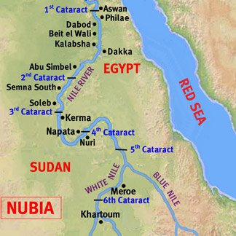
Nubia
Farther south along Nile
Cultural diffusion from ancient Egyptians
But borrowing while retaining unique elements

Slide 6
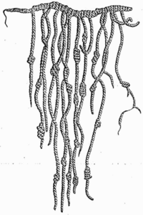
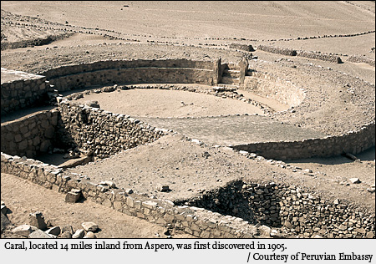
Along the central coast of Peru (3000-1800)
Little rainfall but dozens of rivers
Twenty-five urban centers known as Norte Chico
Economy based to an unusual degree on fishing
Did not rest on grain-based farming
Did not develop pottery or writing
However, existence of a 5,000-year-old quipu
(knotted rope to keep records)

Slide 7
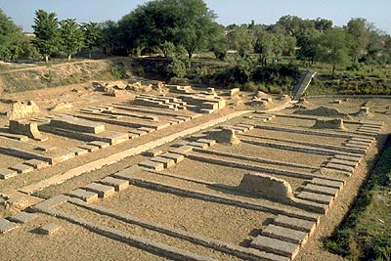
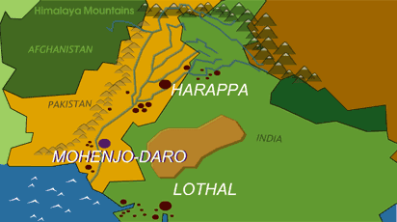
Indus and Saraswati River Valleys in present-day
Pakistan
By 2000 BCE, embraced a larger area than Mesopotamia, Egypt, or coastal Peru
Elaborately planned cities
Standardized weights and even bricks
Irrigated agriculture
Written language, thus far undeciphered
However, generated no kings or warrior classes
Little indication of a political hierarchy

Slide 8
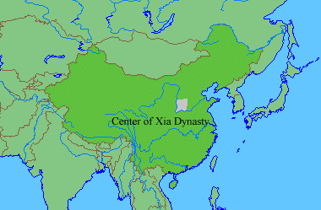
Early Civilization in China
Perhaps as early as 2200 BCE
Ideal of a centralized stated evident from the days of the Xia dynasty (2200-1766)
By Zhou Dynasty, belief that emperor was the Son of Heaven and ruled by Mandate of Heaven
Early form of writing

Slide 9
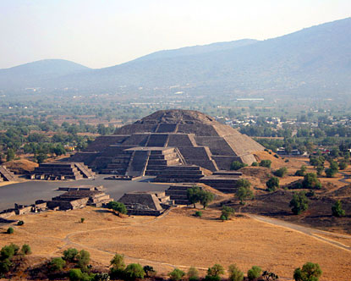
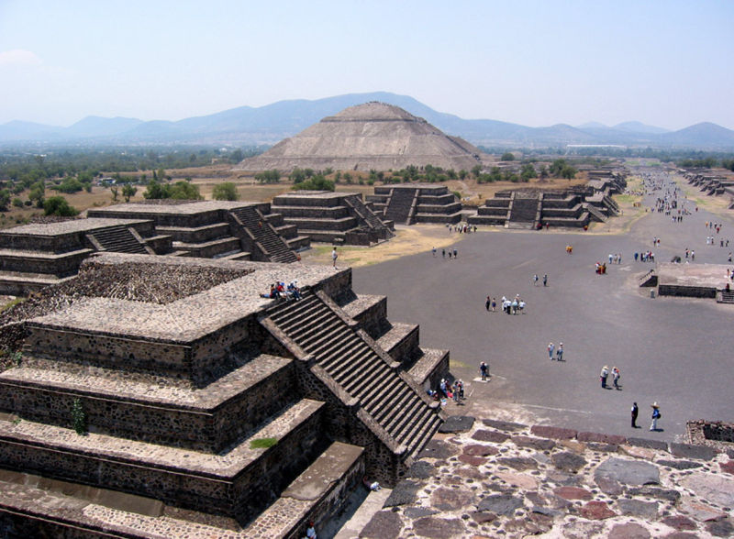
Teotihuacan – located in central valley of Mexico
Perhaps 200,000 people
Dozens of temples
Pyramids

Slide 10
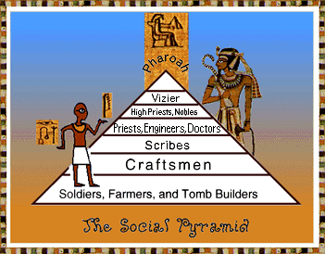
Early Civilizations
Impersonal, no longer possible to know everyone
Class and occupation at least as important as kinship
Increased specialization as agricultural surplus freed some people for different task
Increased inequality
Hierarchies of class
Upper classes – great wealth in land/salaries, able to avoid physical labor

Slide 11
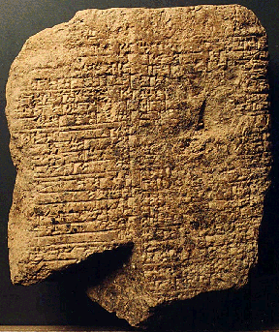
Code of Hammurabi
First written law code
Class divisions – punishments based on social class
Developed in Mesopotamia under Babylonian king

Slide 12
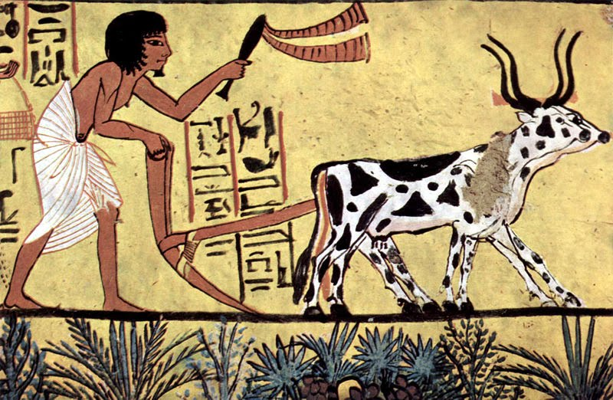
Free Commoners
Vast majority of population
Artisans, low-level officials, soldiers, police, servants, and numerous farmers
Agricultural surplus appropriated through taxes, rent, required labor, and tribute payments to support upper classes

Slide 13
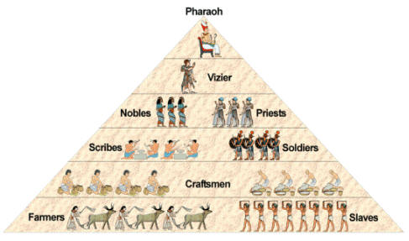
Civilization and slavery
Slaves at the bottom of the social hierarchy
Slavery was practiced in early civilizations but varied depending on region and culture

Slide 14
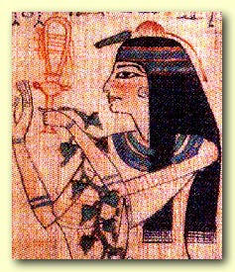
Rise of Patriarchy, New Inequalities for Women
Role of new and more intensive form of agriculture led to men as primary farmers
Men replaced women in agricultural work
Use of animal-drawn plows favored men
Farms at distance from villages also favored men
Increased food production led to increased population
Women more often pregnant in settled communities
With rise of civilization, large-scale military conflict with professional armies also favored men

Slide 15
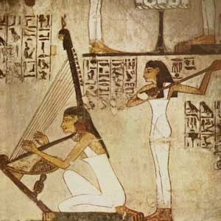
Definition: Patriarchy
Social organization marked by the supremacy of the father in the clan or family, the legal dependence of women and children, and the reckoning of descent and inheritance in the male line
Control by men of a disproportionately large share of power
~ Merriam-Webster Dictionary

Slide 16
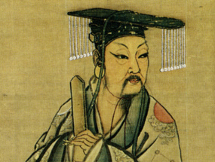
Emergence of kings and states
To coordinate city life and complexities of civilization
To protect settled people from invasions
Kingship regarded as sacred
Kingship through coercion or consent

Slide 17
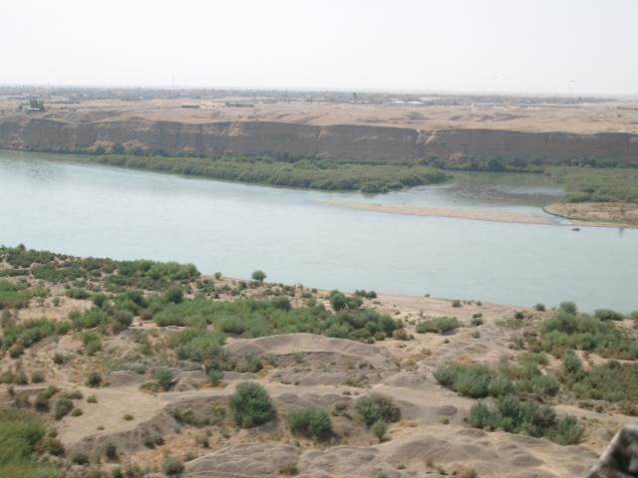
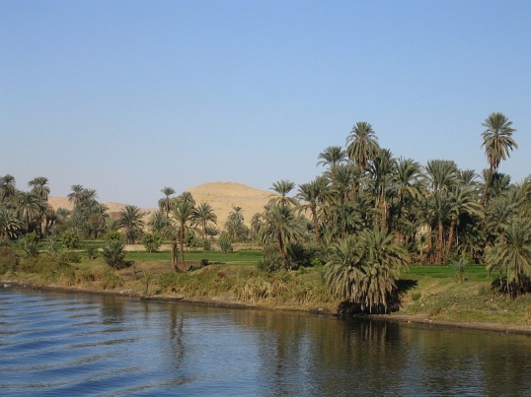
Variations too
Tigris-Euphrates - flooding unpredictable and violent
Mesopotamia – open environment without serious obstacles to travel – vulnerable to invasion
Mesopotamians believed at mercy of whims of capricious gods
Nile – rose predictably
Nile – protection of deserts
Ancient Egyptians – journey to eternal life possible

Slide 18
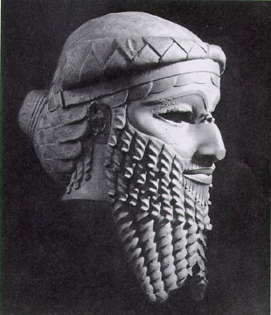
Conquests and Change
Stronger people from northern Mesopotamia conquered Sumerians
First, Akkadians (2350 – 2000)
Babylonians, (1900 – 1500)
Assyrians (900 – 612)
Also trade with region influenced others
Hebrews influenced by Code of Hammurabi’s “eye for an eye”
Phoenicians influenced – developed first alphabet – inspired by Cuneiform

Slide 19
Strayer Questions:
When and where did the First Civilizations emerge?
What accounts for the initial breakthroughs to civilization?
What was the role of cities in the early civilizations?
In what ways was social inequality expressed in early civilizations?
In what ways have historians tried to explain the origins of patriarchy?
What were the sources of state authority in the First Civilizations?

Slide 20
